Slide 1
Legal aid in humanitarian settings
Webinar: The role of legal aid in reparation contexts
7 February 2023

Slide 2
The role of legal aid in reparation contexts
a. enhance synergies between development, humanitarian, human rights and peace actors in the design and implementation of access to justice and legal aid interventions in humanitarian contexts;
b. build sustainable partnerships with national legal aid actors (civil society, private sector, duty bearers) for more sustainable access to justice and legal aid interventions in humanitarian contexts;
c. design and implement legal aid and access to justice interventions aimed at addressing and resolving legal aid needs of hard to reach populations.

Slide 3
The role of legal aid in reparation contexts
Time | Topic
14:00 | Introduction, GPC TTLP - Paola Barsanti, Legal aid Specialist
14:10 | Case Study 1 - Colombia NRC, Maria Fernanda Jaramillo Pinto, ICLA Programme Manager UNDP, Jairo Matallan, Programme Specialist on Rule of Law and Crisis Response UNHCR, Adriana Buchelli, UNHCR
14:40 | Case study 2 – Ukraine Senior Protection Cluster Coordinator Officer, Claudia Nicoletti Right to Protection, Yaroslava Zvolinska, Strategic Litigation Lawyer, Helsinki Human Rights Group, Oleksandr Pavlichenko, Executive Director UNDP, Ivan Jovanović , Human Rights and Rule of Law Advisor
15:00 | Discussion
15:25 | Closing remarks, Martina Caterina, Coordinator GPC TTLP

Slide 4
LEGAL AID AND RESTITUTION OF COLLECTIVE LAND RIGHTS OF INDIGENOUS AND AFRO-COLOMBIAN COMMUNITIES

Slide 5
Background
Colombia has suffered the effects of the internal armed conflict – multiple layers of affected populations
Laws, public policies and jurisprudence focused on the attention and reparation of victims – Victims’ Unit
Right to collective reparation strategies and land restitution
Recognition of collective territories and self-government of ethnic communities – low compliance of the State
State institutions in charge of Land Restitution Unit and National Land Agency
Low community and institutional capacity
Continuity of the armed conflict
Long and complex legal reparation processes – “procesos retributivos”

Slide 6
Legal aid response: ICLA in Colombia
NRC in Colombia operates across several sectors
Information, Counselling and Legal Assistance (ICLA) covering specific thematic areas and multiple target groups, requiring various response strategies
Strong community relationships and ability to keep track of cases/ongoing access
Advocacy actions key to complement legal aid response
Coordination with other actors (institutional, civil society)
Marginalised individuals or communities with low capacity to demand their rights in hard-to-reach areas
Regarding Victims’ Law – ICLA facilitates access to registration, reparation, and land restitution

Slide 7
ICLA support to reparation of indigenous/afro- Colombian communities
Basic methodology:
Community accompaniment
Community strengthening in the enforceability of rights
Legal assistance
Complementary actions
Approaches
Partnerships with universities and strategic litigation organisations to present amicus curiae
Advocacy strategies alongside legal aid actions to manage the State's response
Strategic litigation strategy developed with target communities – holders of the legal action
Constitutional action filed – if negative follow up through Constitutional Court

Slide 8
Good practices
Rights-based, community-based and differential approach
Strengthening traditional practices and establishment of community councils
Use of audio-visual documentary and life histories (awareness & advocacy)
Inter-Institutional Board
Collaboration with other legal aid actors and duty bearers
Report of representatives and traditional authorities to judicial authorities
Conducting advocacy actions to mobilise responses from judicial authorities
Lessons learnt/Challenges
Improve coordination with development, human rights and peace actors
Community interventions plans can be the basis for multi-stakeholder cooperation
Ensure alignment with / inclusion in local development processes to ensure sustainability of the actions
Need for long-term support and presence which requires long-term funding & coordination with development actors
Incentivise strategic and high-impact litigation in humanitarian contexts

Slide 9
NUESTRO 2022
Gracias!

Slide 10
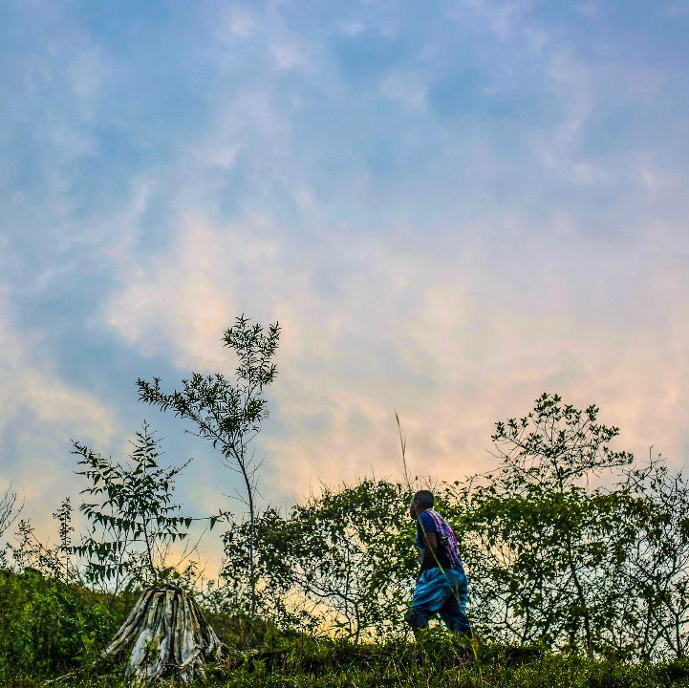
Effective participation of victims in Colombia’s Special Jurisdiction for Peace
Webinar: The role of legal aid in reparation contexts
6 February 2023

Slide 11
Colombia
UNDP Colombia
Programmatic framework
Conflict-sensitive area-based development
Collective reparation to victims
Poverty reduction
Victims and transitional justice
Improved service delivery by TJ institutions
Democratic Governance
Access to justice and HHRR
Peace, justice & reconciliation
Support to victims organizations and
CSOs in Access to TJ
Reintegration and reconciliation
Sustainable development
Crisis response and early recovery
Historical memory

Slide 12
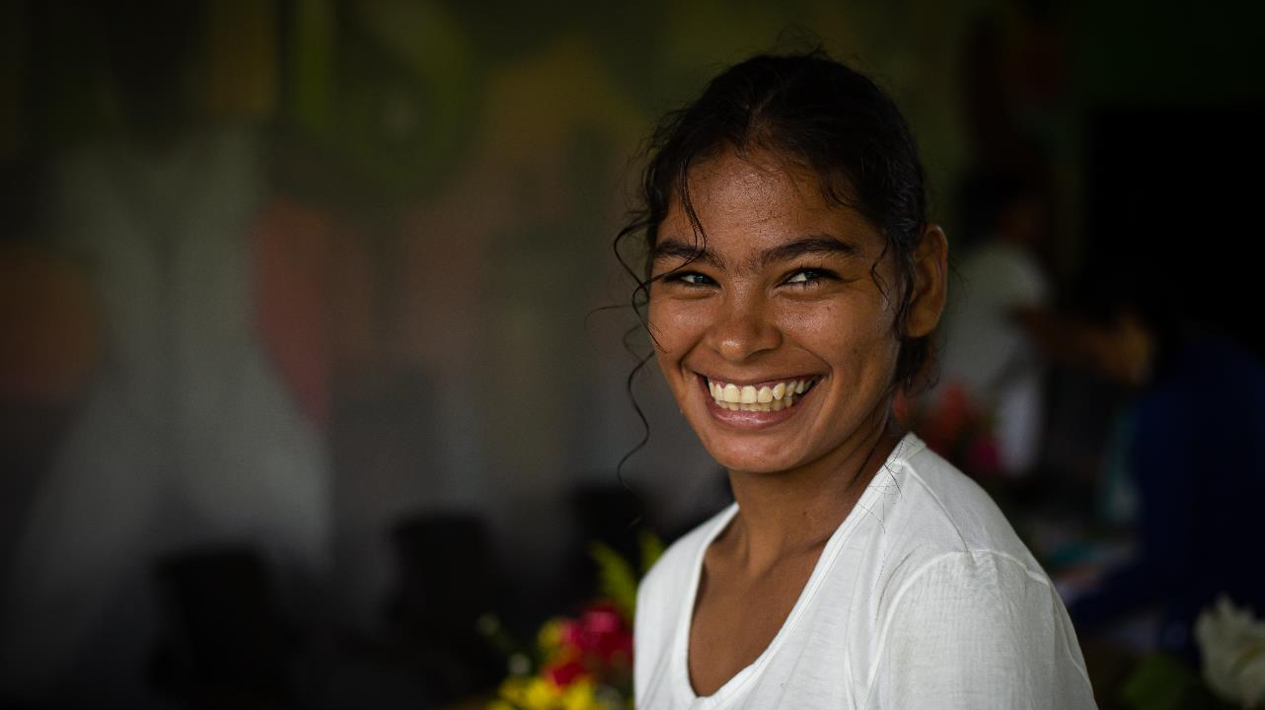
Context
9.405.522
Transitional Justice in Colombia
Registered victims
Antioquia
Cauca
Choco
N. Santander
Meta
Nariño
Caquetá
Córdoba
Act 589 of 2000 on enforced disappearance
Act 975 of 2005 Justicia y Paz (CNRR)
Legislative Act 01 of 2017
Creation of Comprehensive System of Truth, Justice, Reparation and Non-recurrence
Constititional Court Sentence T025 on unconstitutional state of affairs for IDP
Act 1448 of 2011 on Victims and Land Restitution – Creation of SNARIV
Act 378 on IDPs and state responsibility
Final Peace Agreement
1997
2000
2004-2005
2008-2011
2012-2016
2017-2021

Slide 13
Special Jurisdiction for Peace
Key aspects
Colombia
National court with full jurisdictional functions
Coordinated work with Truth Commission (concluded) and Search Unit for Missing Persons
Possibility of restorative sanctions for reparation to victims and reconciliation e.g. demining, search for missing persons, environmental restoration
Investigate, clarify, judge and punish the most serious crimes that occurred in Colombia during more than 50 years of armed conflict.
Nov. 2016
Peace Agreement between Government and FARC-EP guerrilla
15 years
338.554
Feb. 2018 to Feb. 2033
Individual victims registered
13.245
309
Voluntary appearance
Collective victims (indigenous and Afro-Colombian)
74% FARC-EP, 24% Public force,
1% State Agents, 0,1% Social protest
364
10 macro-cases
Reports received by victims, government, academia, and CSOs
7 thematic, 3 region-specific

Slide 14
UNDP support for effective participation of victims
Strengthening of and articulation with CSOs for judicial representation of victims.
Individual and collective protection of victims, defendants and other participating parties
Psychosocial support and logistic assistance for victims’ participation in public hearings and events of recognition of responsibilities
17
CSOs in network with SJP and UNDP
170
Local governments articulated in protection measures
4.528
Individual victims
962
Risk analyses studies
Support to CSOs for advocacy on critical issues (e.g. sexual violence)
Collective victims (over 300.000 associated individuals)
309
+500
Protection measures implemented
State recognition of CSO record on legal aid and HR litigation.
Efficiency and trust building
Personal/community security for participation in TJ mechanisms amidst conflict
Collective protection (e.g. indigenous Awá groups)
Face to fase engagement in the judicial process
Mobilization of critical agendas for victims

Slide 15
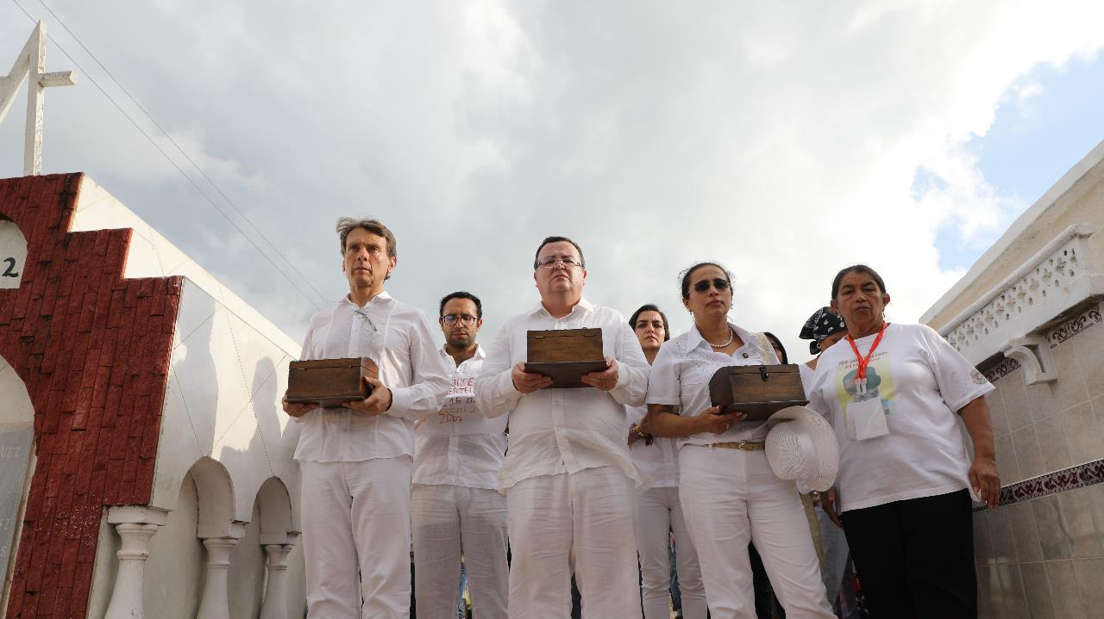
Thank you.

Slide 16
Legal aid in contexts of reparations
UNHCR´s experience in Colombia
February 2023

Slide 17
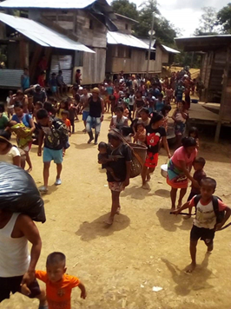
IDP situation in Colombia
8.3 million of IDPs (cumulative since 1985). 6,8 million of IDPs still in need of humanitarian assistance or access to reparations – solutions agenda
Protracted situation but ongoing displacement and confinement. 164,000 newly displaced in 2022, disproportionated impact on Afro and Indigenous communities. New risk´s scenario after 2016 Peace Accord.
Legal and public policy framework according to Guiding Principles. Challenge: implementation of public policies and overcoming of the vulnerability generated with forced displacement
Victim´s Law: full recognition of IDPs as victims, with rights to true, justice and reparation´s rights. Budgetary restrictions to guarantee individual and collective reparations, additional to security conditions in several parts of the country, limited the access to these rights.
Peace Accord with FARC in 2016: creation of transitional justice mechanisms – effort to promote IDP´s access to them – Special Jurisdiction of Peace and Truth Commission

Slide 18
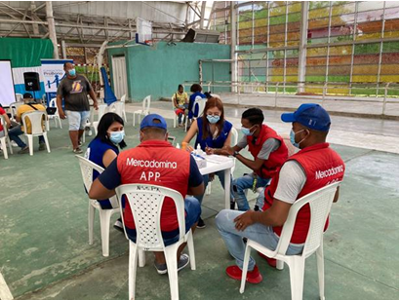
Support IDP´s to access to justice
UNHCR´s wide strategy to promote access to justice to IDPs, and more recently to refugees and migrants.
Network of Legal Clinics of 30 Universities across the country, since 15 years ago. Annually, 18.000 persons attended by the network. Main rights litigated include: access to humanitarian assistance, registry, health and education rights, and access land restitution and to individual reparation (administrative compensation as victim of the conflict)
Support to other legal partners (NGO´s), including ProBono Foundation to promote access to justice to people located in hard to reach areas (rural areas), including access to compensation, for example, to elderly IDP population.
UNCHR´s role supporting Constitutional Court in the follow up to the landmark decision T025/04 which declared Unconstitutional State of Affairs regarding internal displacement. Promote IDP´s participation in specific hearings with the Constitutional Court.

Slide 19
Support to IDP´s to access to their rights as victims
UNHCR´s one of international supporters of the Peace Accord, in particular to the Victim´s Rights
Support to the Truth Commission: special focus on displacement in border areas (connection with exile and transborder movements to other countries), with IDPs participation and presentation of reports to the Commission. Visibilization of impact of Colombia´s exile. Next step: support implementation of CEV´s Final Report recommendations
Support to the Special Jurisdiction of Peace:
investigation of internal displacement crime – mainstreaming its investigation in at least three “macro cases” (JEP´s investigation on FARC, Public Forces and Ethnic Cases)
Support to IDPs organisations to present reports to JEP and support to their participation on public hearings

Slide 20
Domestic remedies in HLP cases
Nowadays there are no effective domestic remedies in Ukraine in context of reparation for ruined or damaged housing after the full-scale aggression of Russia on 24 February 2022.
However there two mechanisms used by Ukrainian lawyers since 2014 when Russia invaded into the eastern part of Ukraine:
Court mechanism: claims lodged with Ukrainian courts against Ukraine and Russia
Administrative mechanism: obtaining of fixed compensation under administrative procedure established by the Ukrainian Government.

Slide 21
Court mechanism
Claims against Ukraine
Position of the Supreme Court in number of HLP cases supported by R2P:
- with regard to the right guaranteed by Article 1 of Protocol no. 1 to the Convention on Human Rights, the positive obligations of the State, may include certain measures necessary to protect the right to property: the State must provide in its legal system legal guarantees for the realization of the right to property and legal remedies by which the victim of interference with this right can protect it, in particular, by claiming damages for any loss; take all appropriate measures to protect property within its jurisdiction;
- the absence in the legislation of Ukraine of relevant provisions on compensation to the owner of property damaged during the hostilities;
- the beneficiaries are entitled to compensation from Ukraine from EUR 600 to EUR 3000.
Main shortcomings:
the sums of compensation are granted by the national courts for the absence of legal remedies at the domestic level and as a result they are not equivalent to pecuniary losses of victims which usually are estimated much higher.
Claims against Russia
The Supreme Court gave “green light” for domestic courts to consider cases against Russia on the recovery of compensation for damage caused by Russian aggression since 2014.
Main points of the decision:
- given the fact that Russia, as an aggressor state, grossly violates the norms and principles of international law, does not fulfill its obligations under international treaties in good faith and cannot claim immunity from prosecution in Ukraine. Accordingly, there is no need to obtain the consent of Russia to consider the case against it in a Ukrainian court.
- the national legislation of Ukraine proceeds from the fact that, as a general rule, damage caused to an individual in Ukraine as a result of unlawful actions of any other person (entity) may be compensated by a decision of a court of Ukraine
There are a number of positive decisions of domestic courts against Russia, however there is currently no mechanism for enforcement of decisions of domestic courts in such cases.

Slide 22
Administrative mechanism
The compensation mechanism under the Resolution of the Cabinet of Ministers of Ukraine
provides payments max about EUR 9000 for ruined housing and about EUR 1100 for damaged housing.
In the majority of cases these sums are not equivalent to pecuniary losses of victims which usually are estimated much higher. Taking into account costs on real estate property and building materials the above compensation does not give opportunity to the victims to renovate housing in proper manner, to rebuild or to buy new housing of satisfactory quality. However in some cases the above sums of compensation were satisfying for R2P’s beneficiaries.
compensation is provided to those victims who remained at the previous place of residence and/or within the relevant settlement.
This provision excludes from potential compensation the internally displaced persons
compensation is provided to those victims whose own housing is located in the territories controlled by Ukraine.
This provision excludes from potential compensation the victims residing on the occupied territories.
envisages waiver from ownership on the behalf of the state.
Draft law “On compensation for damage and destruction of certain categories of real estate as a result of hostilities, terrorist acts, sabotage caused by the military aggression of the Russian Federation” is considered by the Ukrainian parliament.

Slide 23
About the Right to Protection Charitable Foundation
R2P is one of the leaders of the human rights movement in Ukraine, with a strong position in the field of protection of the rights of IDPs, refugees and stateless persons. R2P actively cooperates with partner and donor organizations
R2P provides legal aid to IDPs, refugees and stateless persons since 2013 in the following directions: legal consultations (hotline and live); legal support before the state authorities; representation in the courts.
R2P has an established internal and external referral system. R2P internal CRM system is used by monitors and lawyers for referring cases and the follow up. MPC team uses internal tool (special excel file) for referring cases to R2P hotline with further follow up. The external referral system is different depending on the region and the partner.
R2P’s cases as to compensation:
60 beneficiaries who were assisted in obtaining compensation through the administrative mechanism;
about 20 cases against Ukraine in which R2P’s lawyers won on positive obligations:
we do not conduct cases against Russia, as there are issues of immunity of the Russian Federation and enforcement of decisions.
Advocacy department is currently working to finalize and implement compensation mechanisms under the draft law

Slide 24
Ukrainian Helsinki Human Rights Union
Free legal aid system https://legalaid.gov.ua/
UHHRU – 20 Public reception offices.
Complex approach: documentation, legal aid, strat litigation
In 2022 was provided around 15 000 consultations
IDPs – more then 53%
Appeals for reimbursement and compensation in 2022 were among the most frequent and accounted - 15% of all appeals

Slide 25
Challenges
Gray zone of law on occupied territories. The issue of the verdict and judicial solutions on occupies territories.
Responsibilities for legal professionals “judges”, “prosecutors”, advocates. Transitional Justice approach
Penitentiary issues
Crossboarding consultations

Slide 26
Solutions
Strategic litigation
The issue of the mechanism for collecting information about destroyed property through "DIYA" and what nuances there may be regarding compensation was also analyzed https://helsinki.org.ua/articles/kompensatsiia-na-vidnovlennia-zruynovanoho-mayna-ta-infrastruktury-v-dodatku-diia-iak-tse-pratsiuvatyme/
Legislation
Based on the practical information from victims of the military conflict received through the reception center, a legal analysis of the draft laws submitted on this issue was made. For example, regarding the draft law No. 5177 https://helsinki.org.ua/articles/kompensatsiia-za-porusheni-pravo-vlasnosti-ta-rechovi-prava-postrazhdalykh-vnaslidok-zbroynoi-ahresii-rf-pravovyy-vysnovok-uhspl-shchodo-zakonoproiektu-5177/

Slide 27
UNDP and free legal aid
The 2030 Agenda for Sustainable Development: peaceful, just, and inclusive societies which provide equal access to justice and are based on respect for human rights
SDG 16, target 3: ensuring access to justice for all in achieving sustainable development
Instrumental for the Humanitarian-Development-Peace nexus and UNDP’s people-centered approach, incl. in helping those impacted by conflicts and human rights violations
Development of legal aid systems in UNDP’s work:
direct goal
a tool for achieving other goals (poverty reduction, gender equality and women empowerment, services for vulnerable groups, human rights protection, transitional justice, etc.)

Slide 28
Ukraine, war, and free legal aid (FLA)
Well developed FLA (hybrid – dedicated state authorities, contracted lawyers; co-operation with CSOs); broad range of potential beneficiaries; IDPs, war veterans, victims of CRSV, torture and ill-treatment added as categories
Since 2014 - territorially limited armed conflict (Donetsk and Luhansk, occupation of Crimea)
In 2021: 33 000 cases - involving low-income individuals, 10 000 - people with disabilities, 5 500 - IDP cases, 29 000 - military personnel or combatants; 59% of clients were women
Since 24 Feb 2022 - full scale invasion
Main challenges: extreme systemic stress, ongoing destruction scale (loss of life, torture, CRSV,, loss of property, livelihoods, documentation, etc.); IDPs, refugees, victims of the conflict; competing needs (defence and security as priorities); martial law
Comparative advantages: functional and resilient institutions and FLA, experience since 2014, political commitment, strong social contract, EU accession, quick international support
FLA continues to perform; 78 % of general population and 83 % IDPs rank satisfaction with FLA system highly (Nov 2022 survey, UN Recovery and Peacebuilding Programme).

Slide 29
UNDP support to free legal aid system in Ukraine
Working with national authorities on delivery of legal aid services to conflict-affected population (key partner: Free Legal Aid Coordination Center-FLACC):
Support to online solutions for improving A2J: e.g. Mobile app “Tvoe Pravo/Your Right” (legal advice and step-by-step guidance); Client’s Cabinet (uploading e-signed docs and receiving procedural docs or legal advice)
Online learning courses for paralegals and professional lawyers
HelpDesk – tracking and distribution of legal aid requests
Technical support to FLACC to address new challenges during the full-scale invasion (from info materials to equipment for relocated FLA local centers)
Further integration of mediation into FLA system
UNDP and FLACC MoU (2021) on co-operation and advancing new FLA approaches

Slide 30
UNDP support to free legal aid system in Ukraine
Partnership with local civil society actors to improve local level access to justice, since 2017 (examples):
Reaching out to remote settlements and people living close to the Contact Line in Luhansk oblast through CSOs
Training paralegals among local Roma community in Luhansk Oblast
Advocacy and hiring of lawyers in local pilot communities in Donetsk and Luhansk oblasts
Support to small and newly created CSOs to start off their activity
Provision of free legal aid services to IDPs in 4 transit and 5 host communities (emergency response grant project, ongoing; so far - 18,000 consultations for over 6,000 IDPs)
Capacity development of 20 local CSOs as legal aid providers in transit and host communities (ongoing grant project)

Slide 31
Expanding role for free legal aid in Ukraine
Other expanding or potential roles for areas of support (esp. in relation to transitional justice):
Criminal accountability for war crimes
Victim support (to victims of war crimes; comprehensive victim support system for all criminal cases, etc.)
Reparations
FLA provision and many measures and services with reparatory effect, no comprehensive and dedicates reparations system yet
development of long-term and comprehensive reparations framework: inclusive consultations ongoing, Government in the lead, political commitment
possible interim reparations mechanism for most vulnerable groups (CRSV survivors)
important future role of FLA in reparations

Slide 32
The role of legal aid in reparation contexts
✔ What role can legal aid play in the implementation of reparation policies and programmes?
✔ How have humanitarian and development actors coordinated their efforts to design and implement more effective, collaborative and joint legal aid interventions in reparation contexts?
✔ How have protection actors enhanced the sustainability of their legal aid and access to justice
interventions in reparation contexts through partnership with national legal aid actors (civil society, private sector, Bar Association, informal dispute resolution mechanism, etc…)?
✔ Were legal aid interventions in reparation contexts able to address and respond to the needs of hard to reach population? How?
✔ What are some of the most common challenges, key lessons learnt and good practices that can be shared in all these areas (humanitarian/development cooperation, working with local partners, addressing the needs of hard to reach populations)?
✔ What tools are available to support those interested to do more in this area?

