Slide 1
Humanitarian Programme Cycle 2027
Introduction to Severity, PiN and Target Tools – Protection Cluster
30 June 2026

Slide 2


AGENDA
Purpose of the Session
Key Takeaways
Overview of the Tools Package
Notes:
Today's session will walk through the Protection Cluster Severity and PiN methodology and the tools available to support the 2027 HPC process. We will start with the overall analytical approach and key assumptions, then move into live demonstrations of the Household-Level, Area-Level, and Data-Poor Scenario tools. We will also look at the Severity and PiN validation process and conclude with the Targeting Matrix used to support prioritization and response planning. By the end of the session, participants should have a clear understanding of how the different tools fit together and how to apply them consistently in their operations

Slide 3

Needs and Target – Tools & Guidance
Tools
  01_tool_protection_risk_need_severity_pin_scenario01_household_level
  02_tool_protection_risk_need_severity_pin_scenario02_area_level
  03_tool_protection_risk_need_severity_pin_scenario03_data_poor
  04_tool_protection_severity_pin_check
  05_Protection_Cluster_Consolidated_Target_Prioritization_Matrix - template
Guidance
  GUIDANCE NOTE - Protection Severity PiN HH Area Level Tool for 2027 HPC
  GUIDANCE NOTE - Protection Severity & PiN Data Poor Scenario Tool for 2027 HPC
  GUIDANCE NOTE - Protection Targeting Tool for 2027 HPC
  GUIDANCE NOTE – People Exposed to Risks Prediction Model

Slide 4
Scope
The methodology and tools support the calculation of both the Protection Cluster Severity & PiN and the response type-specific caseloads for:
  Gender-Based Violence (GBV)
  Child Protection (CP)
  Mine Action (MA)
  Housing, Land and Property (HLP) *
The approach can be implemented through a single integrated process or through separate calculations by dedicated response type IMOs, depending on available IM capacity.
In the operations where the transition of House, Land and Property (HLP) to the Shelter, Land and Site Cluster has not been completed, the related HLP caseload should be considered in the process and in the inclusion within the HNRP chapter, according to the agreed protection cluster approach.

Slide 5
Key Analytical Assumptions
TOP LINE MESSAGES
Protection Severity and PiN are calculated first using Protection Core Indicators * and serve as the basis for response type analyses.
A single integrated tool is recommended to support consistency and reduce consolidation efforts.
Use of Sex, Age and Disability Disaggregation (SADD) data is recommended.
Response type severity classifications and PiN estimates should not exceed overall Protection results for the same location or population group.
Any exception in Severity must undergo Expert Judgement review, including the mandatory use of the Protection Risk Score as a balancing check.
Final decisions on adjustments or retention of results rest with the Protection Cluster Coordinator.
Where a core indicator is unavailable, identify and use alternative indicators that measure the same protection needs dimension or risk.

Slide 6
Reporting and HNRP Presentation
TOP LINE MESSAGES
The Protection Cluster IMO is responsible for submitting final Severity and PiN figures to OCHA..
Results are presented under a single Protection Cluster chapter in the HNRP narrative.
HNRP at-a-glance visuals display only overall Protection figures (Severity, PiN, targets and budget requirements).
Response type-specific caseloads, targets and budgets remain visible within the Protection Cluster narrative to ensure recognition of GBV, CP and Mine Action needs and support coordinated planning.

Slide 7
The Analysis Process
Household / Area Level Tools
Protection Risks Data Scenario
1. Top 5 Protection Risks Severity
1. Protection Risks Severity Scoring
6. HH / Area Crisis Index - Pillars 1 to 3 severity & Final Severity HH/Area level
7. Needs Severity and PiN by population groups and Response Type
2. Severity Expert Judgement
2. People Exposed to Risks (PeR) / or Affected Population
5. MSNA HH / or Area level dataset
8. Needs Severity adjustment – Protection Risks and Expert Judgement
3. PiN (Distribution by Proportional score allocation using final severity)
3. Core Indicator selection
4. Assigning Preference Scores (1-3)
9. Final Needs Severity & PiN
Targets (using access, needs severity, operational presence and response coverage filters)

Slide 8
List of Core Indicators
N | Areas | Indicators | Pillar of Need
1 | ALL | % of households reporting changes on how they move around or access public spaces due to the presence of protection threats in the community in the last 3 months. | Pillar 1
2 | Mine Action | Size and location of areas contaminated by explosive ordnance (defined as mines, cluster munitions, unexploded ordnance, abandoned ordnance, booby traps, improvised explosive devices and other devices). | Pillar 1
3 | Gender-Based Violence / Child Protection | Over the past 3 months, how often, if ever, women, boys and girls of your household had to avoid areas of the community, such as markets and waterpoints, because of security concerns? What areas or places do they usually avoid due to security concerns? | Pillar 1
4 | ALL / Gender-Based Violence / Child Protection | % of HHs engaging in harmful coping mechanisms in the last 30 days | Pillar 2
5 | ALL | % of households reporting difficulties in accessing resources, doing activities or making choices to meet their needs due to the presence of protection threats in the community in the last 3 months | Pillar 2
6 | ALL | % of households reporting difficulties in participating in social interactions, activities or decisions due to the presence of protection threats in the community in the last 3 months. | Pillar 2
7 | ALL | % of households reporting negative changes in the behavior of children in the last 3 months | Pillar 2
8 | ALL | % of households reporting difficulties in accessing services due to the presence of protection threats in the community in the last 3 months | Pillar 3
9 | ALL / HLP | % of households reporting difficulties in accessing justice, legal services or legal documents due to the presence of protection threats in the community in the last 3 months | Pillar 3

Slide 9
SEVERITY & PiN
1. Household level tool
2. Area level tool

Slide 10
People in Need
Data Collection & Indicators
  Start with selecting 6-10 core indicators across mobility, safety, practices, and service access pillars.
  Minimum 2 per pillars.
Severity Scoring
  Severity combines risk and pillar scores using weighted averages and a 20% validity rule.
People in Need Estimation
  People in need (PiN) are identified by severity levels 3 to 5 representing high-risk populations.
How Needs are Measured
Severity Calculation
PiN Estimation

Slide 11
Assigning Preference Score
WHAT THE WORKSHEET DOES
Household / Area Level Tools
Assigns contribution scores (1–3) to response options.
Scores reflect the relative importance of each response.
Scores are inputs to the model, not final severity classes.
WHY 1 -3 SCALE
Prevents a single indicator from driving extreme severity.
Encourages severity to emerge from multiple factors combined.
Reduces inflation of Severity 5 classifications.
Survey Response
🚶 Movement Restr.
🚨 Emergency Coping
🚫 Service Barrier
Pillar Severity Score
Multiple indicators
Household or Area level severity
Not driven by one indicator alone
Preference Scores
Low Impact: 1
Medium Impact: 2
High Impact: 3
- A score of 3 does not automatically mean Severity 3.
- Severity is determined by the combined effect of multiple indicators, not by a single response option.
Notes:
Produces a more balanced severity distribution.

Slide 12
Household (HCI) / or Area Crisis Index (ACI)
WHAT THE WORKSHEET DOES
Household / Area Level Tools
Serves as the main scoring sheet for household or area analysis.
Pulls indicator responses and applies the predefined preference scores.
Generates severity scores for each protection needs pillar.
Produces the final household or area severity classification (for a given population group).
SEVERITY CALCULATION LOGIC
Final Severity is determined using the highest pillar score (MAX).
This reflects a worst-case protection analysis approach, where a severe problem in one pillar is sufficient to drive overall severity.
ABILITY TO MOVE AND ACCESS TO PUBLIC SPACES
ABILITY TO PARTICIPATE IN SAFE PRACTICES AND ACTIVITIES
ACCESS TO RIGHTS AND SERVICES
The Crisis Index is the engine of the methodology: indicator responses → pillar scores → final severity, using a worst-case protection logic based on the highest pillar score.

Slide 13
Severity & PiN (by population groups) – Household Level Tool
WHAT THE WORKSHEET DOES
Household Level Tool
Aggregates household severity results to administrative area and population-group level.
Uses MSNA survey weights to calculate representative severity phase distributions.
Calculates the percentage of households in Severity 1–5 for each population group.
Applies the 20% rule to derive the final population-group severity classification.
WHY MSNA WEIGHTS ARE USED
Representative severity distributions
More accurate PiN calculations.
Severity Scores by Area Level
Severity Phase Distribution
(1 – 5 )
20% rule
Moderate PiN
Acute PiN
Total PiN
Population Groups IDPs, Hosts, Returnees, etc
The Severity and PiN worksheet transforms household level severity results into population-level severity distributions and PiN estimates, providing the final evidence base for Protection Cluster planning, prioritization, and HNRP reporting.

Slide 14
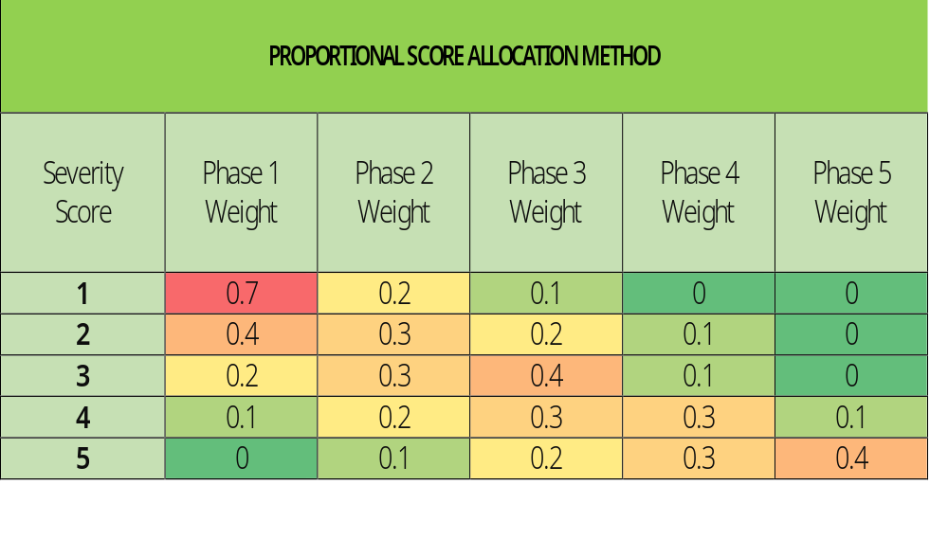
Severity & PiN (by population groups) – Area Level Tool
WHAT THE WORKSHEET DOES
The assigned severity phase receives the largest share of the population, while neighboring phases receive smaller shares, reflecting variation in conditions within an area.
Population is distributed proportionally across severity phases rather than assigned entirely to a single phase, creating a more realistic severity profile.
For example, an area classified as Severity 3 allocates most people to Phase 3, with smaller shares in adjacent phases and typically no allocation to Severity 5.
Area Level Tool
Area Tool uses the final severity score from the Area Crisis Index (ACI) worksheet and distributes the affected population across severity phases using predefined allocation patterns.
Severity Scores by Area Level / Population Groups
Population Distribution Across Severity 1 to 5
Moderate PiN
Acute PiN
Total PiN
Proportional Allocation Table
The Severity and PiN worksheet transforms household level severity results into population-level severity distributions and PiN estimates, providing the final evidence base for Protection Cluster planning, prioritization, and HNRP reporting.

Slide 15
Key Differences – Household and Area Level Tool
Household / Area Level Tools
Household Tool | Area Tool
Uses household-level severity results | Uses area severity score
Applies MSNA survey weights | Applies proportional allocation weights
Produces weighted phase distribution | Produces modeled phase distribution
PiN based on survey representation | PiN based on area severity allocation
The Severity and PiN worksheet transforms household or area severity results into population-level severity distributions and PiN estimates, providing the final evidence base for Protection Cluster planning, prioritization, and HNRP reporting.

Slide 16
SEVERITY & PiN
3. Data Poor Scenario tool

Slide 17
Severity & PiN (by population groups) – Data Poor Scenario Tool
WHAT THE WORKSHEET DOES
Import Protection Risks Severity Analysis Scores.
Select Top 5 Protection Risks.
Populate population data by SADD (PeR / or Affected).
Final severity score is used to distributes the PeR / or Affected population across severity phases using proportional allocation table.
Generate PiN.
Data Poor Scenario Tool
Protection Risks Severity Tool Outputs
Population Distribution Across Severity 1 to 5
Moderate PiN
Acute PiN
Total PiN
Population Groups IDPs, Hosts, Returnees, etc
The Data-Poor Scenario Tool provides a practical approach for generating Severity and PiN estimates when household-level assessment data are unavailable, using Protection Risk analysis, affected population figures, and proportional severity allocation.

Slide 18
TARGETING

Slide 19
Target Prioritization Matrix Tool
1. Protection Severity & PiN (previous year)
6. Priority Classification
7. Target Coverage (% of PiN)
Targeting
2. Access Conditions
5. Priority Score
8. Final Target
3. Partners Presence
4. Existing Response Coverage
Targets are driven by both the intensity of protection needs (severity) and operational priority considerations, ensuring transparent and consistent response planning.
Notes:
Prioritize locations and determine an indicative target caseload by combining protection needs with operational realities.

Slide 20
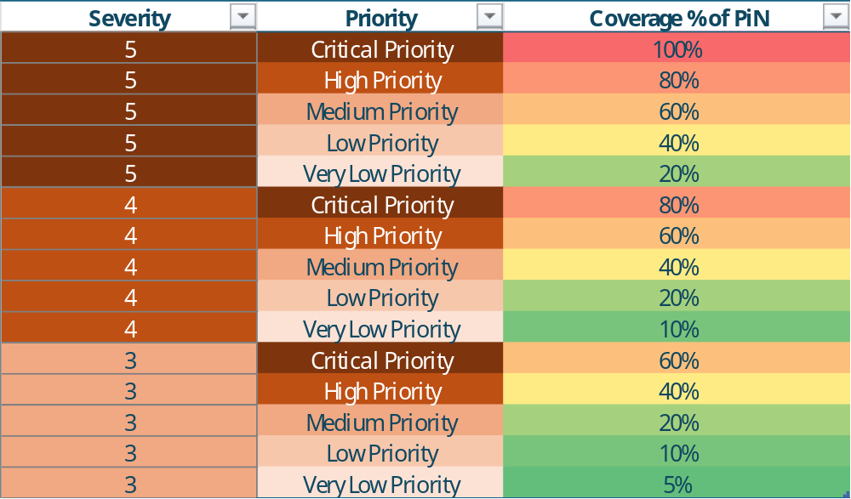
Target Prioritization Matrix Tool
Filter | Purpose | Max Score (8)
Access Feasibility | Operational access constraints | 5
Partner Presence | Availability of protection actors | 1
Response Coverage | Existing reach and service gaps | 2
Targeting
Priority Score combined with Severity of Needs
Severity Level + Priority Category
↓
Coverage % of PiN
Notes:
Prioritize locations and determine an indicative target caseload by combining protection needs with operational realities.

Slide 21
RESOURCES

Slide 22
Resources
Tools
  01_tool_protection_risk_need_severity_pin_scenario01_household_level
  02_tool_protection_risk_need_severity_pin_scenario02_area_level
  03_tool_protection_risk_need_severity_pin_scenario03_data_poor
  04_tool_protection_severity_pin_check
  05_Protection_Cluster_Consolidated_Target_Prioritization_Matrix - template
Guidance
  GUIDANCE NOTE - Protection Severity PiN HH Area Level Tool for 2027 HPC
  GUIDANCE NOTE - Protection Severity & PiN Data Poor Scenario Tool for 2027 HPC
  GUIDANCE NOTE - Protection Targeting Tool for 2027 HPC
  GUIDANCE NOTE – People Exposed to Risks Prediction Model
  GUIDANCE NOTE – JIAF 2.0 Outcome Indicator for 2027 HPC
  GUIDANCE NOTE – Costing Methodology for 2027 HPC (pending)

Slide 23
Q & A
Please contact Kashif & Francesco before you start planning to support you coherently given the current reset
decisions at country and global level (rehmanka@unhcr.org, michele@unhcr.org )

