Slide 1
Humanitarian Programme Cycle 2027
Refresher on Tools and Methodology – Protection Cluster
11 June 2026

Slide 2


AGENDA
Refresher on needs, response analysis methodology
Response Monitoring

Slide 3
HUMANITARIAN PROFILE

Slide 4
Humanitarian Profile - The Onion Model
Total Population
People Affected
People affected by the crisis
People Exposed to Risks (PER)
Population exposed to 15 protection risks
Protection PiN
Severity 3–5
Require humanitarian assistance
People Targeted
Subset of PiN planned for response
Based on access, capacity, prioritization
People Reached
People Reached / covered

Slide 5
1. RISK ANALYSIS

Slide 6
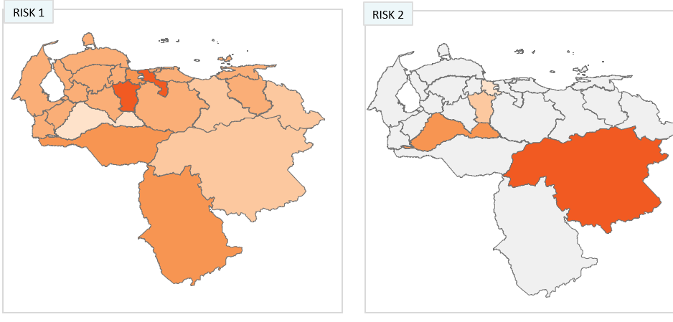
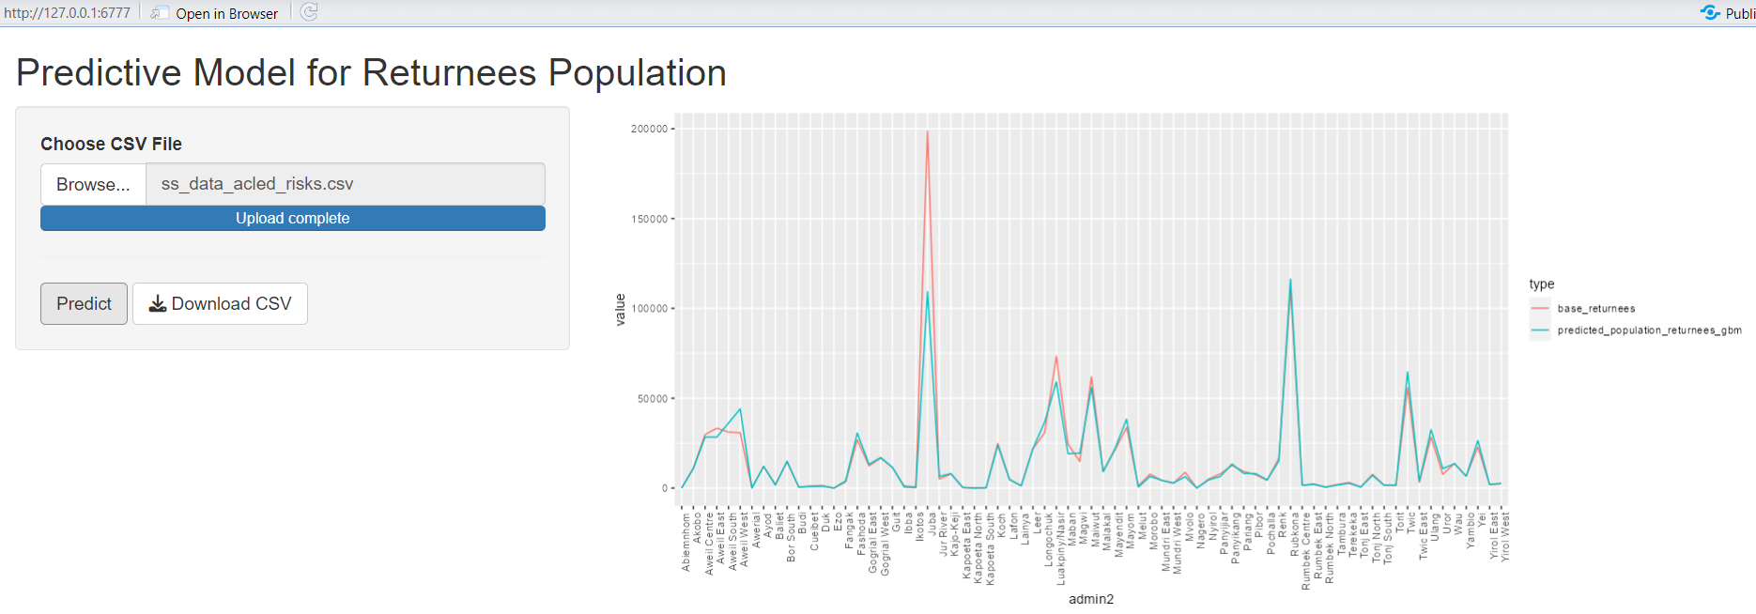
Analysis of Risks
PROTECTION RISKS SEVERITY - GPU
SUBNATIONAL VALUE JUDGEMENT - JUNE TO AUGUST
OUTPUT: SEVERITY DATA ON 15 RISKS
PEOPLE EXPOSED TO PROTECTION RISKS
AUTOMATIZE TOOL: PREDICTIVE MODEL TO CALCULATE BASED ON RISKS SEVERITY AND OTHER DATA
OUTPUT: N. OF POPULATION ESTIMATED AT RISK
Notes:
Better calculation of the affected population, to identify the subset of people exposed to Protection risks.
Use of baseline Protection risks population, to identify the subset People in Need.
How we do it.
We revised the Global Protection Update approach we used since 2022. Now is done at subnational level, and is based on expert judgement
We have an automatize model that calculates the projected people at risks, from the OCHA population data
The previously defined 3 pillars, are used as proxy indicators to identify PIN
At the last stage, we have introduced modalities that better adapt to available data: no data, area level data and household data.

Slide 7
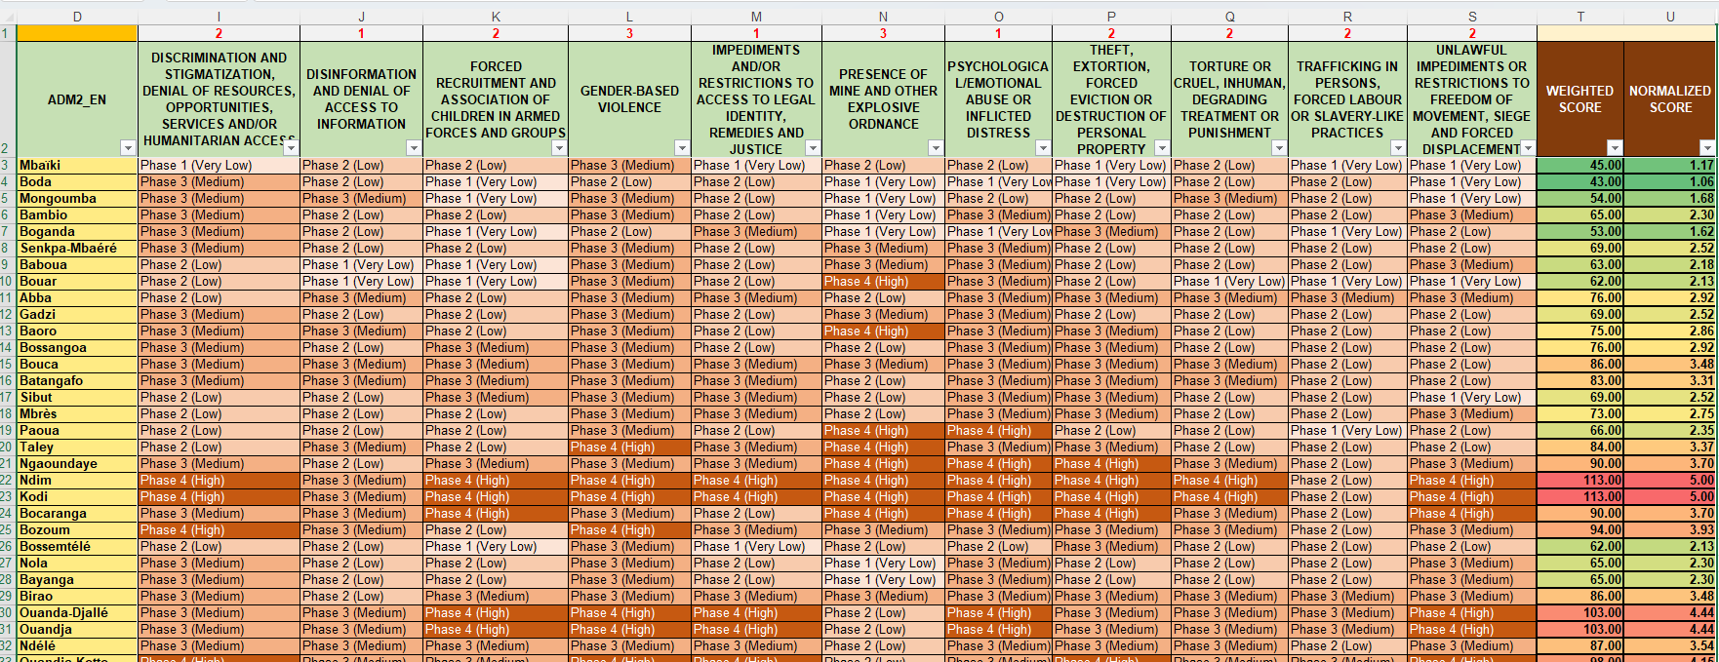
Analysis of Risks: The Excel matrix
SUBNATIONAL VALUE JUDGEMENT IN JUNE AND SEPTEMBER
PROTECTION RISKS SEVERITY - GPU
Notes:
Better calculation of the affected population, to identify the subset of people exposed to Protection risks.
Use of baseline Protection risks population, to identify the subset People in Need.
How we do it.
We revised the Global Protection Update approach we used since 2022. Now is done at subnational level, and is based on expert judgement
We have an automatize model that calculates the projected people at risks, from the OCHA population data
The previously defined 3 pillars, are used as proxy indicators to identify PIN
At the last stage, we have introduced modalities that better adapt to available data: no data, area level data and household data.

Slide 8
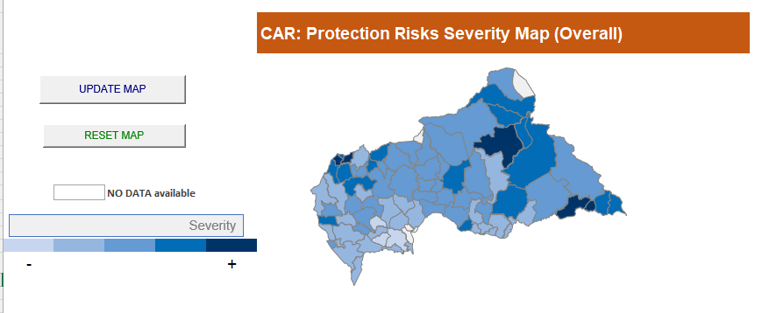
Analysis of Risks: Output of The Tool
SUBNATIONAL VALUE JUDGEMENT IN JUNE AND SEPTEMBER
PROTECTION RISKS SEVERITY - GPU
Notes:
Better calculation of the affected population, to identify the subset of people exposed to Protection risks.
Use of baseline Protection risks population, to identify the subset People in Need.
How we do it.
We revised the Global Protection Update approach we used since 2022. Now is done at subnational level, and is based on expert judgement
We have an automatize model that calculates the projected people at risks, from the OCHA population data
The previously defined 3 pillars, are used as proxy indicators to identify PIN
At the last stage, we have introduced modalities that better adapt to available data: no data, area level data and household data.

Slide 9
Analysis of Risks – People Exposed to Risks Model
The model uses XGBoost algorithm, known for its efficiency and accuracy in handling complex datasets through an ensemble of decision trees.
FIXED: Protection Risks severity score
OTHERS: chosen at country level (Example: ACLED data on events and fatalities)
Notes:
Here you can see a screenshot of the online predictive model tool.
It uses the severity of protection risks done in each country at subnational level
It allows uploading other “predictors” (data): PIN, severity of previous years, ACLED data, country specific).

Slide 10
2. NEEDS ANALYSIS

Slide 11
Analysis of Needs
PROTECTION RISKS SEVERITY - GPU
SUBNATIONAL VALUE JUDGEMENT – JUNE to SEPTEMBER
OUTPUT: SEVERITY DATA ON 15 RISKS
PEOPLE EXPOSED TO PROTECTION RISKS
AUTOMATIZE TOOL: PREDICTIVE MODEL TO CALCULATE BASED ON RISKS SEVERITY AND OTHER DATA
OUTPUT: N. OF POPULATION ESTIMATED AT RISK
3 PILLARS TO DEFINE PROTECTION NEEDS
IDENTIFICATION OF NEEDS INDICATORS (6-10 CORE INDICATORS)
JUNE-AUGUST
ABILITY TO MOVE AND ACCESS TO PUBLIC SPACES
ABILITY TO PARTICIPATE IN SAFE PRACTICES AND ACTIVITIES
ACCESS TO RIGHTS AND SERVICES
OUTPUT: SEVERITY OF NEEDS
PEOPLE IN NEED
STREAMLINED APPROACH FOR CALCULATION AND AGGREGATION (HH, AREA LEVEL & DATA POOR)
OUTPUT: SUBSET OF POPULATION IN NEED - PIN
Notes:
Better calculation of the affected population, to identify the subset of people exposed to Protection risks.
Use of baseline Protection risks population, to identify the subset People in Need.
How we do it.
We revised the Global Protection Update approach we used since 2022. Now is done at subnational level, and is based on expert judgement
We have an automatize model that calculates the projected people at risks, from the OCHA population data
The previously defined 3 pillars, are used as proxy indicators to identify PIN
At the last stage, we have introduced modalities that better adapt to available data: no data, area level data and household data.

Slide 12
MSNA Coverage - 2026
Country | Level of Data Collection
Afghanistan | National coverage at the Admin-2 level
Burkina Faso | National coverage at the Admin-2 level
Central African Republic | Planning for national coverage, but depending on funding, might focus on high-need areas if funding is limited
The Democratic Republic of Congo | MSNA at district level (5 districts) – geographic coverage subject to change depending on the Ebola outbreak
Haiti | Nationwide assessment, representative at Admin-1 level and Admin-2 level in ZMPAP
Myanmar | Nationwide, with the level of remote data collection to be determined by the fuel crisis and access constraints – Admin-1 level of representativity
Mali | Aim for national coverage at the Admin-2 level
Palestine | Coverage to be defined with partners
Ukraine | MSNA will be crisis-wide this year rather than national-level (West & Center not included)
Venezuela | Coverage to be defined with partners

Slide 13
List of Core Indicators
N | Areas | Indicators | Pillar of Need
1 | ALL | % of households reporting changes on how they move around or access public spaces due to the presence of protection threats in the community in the last 3 months. | Pillar 1
2 | Mine Action | Size and location of areas contaminated by explosive ordnance (defined as mines, cluster munitions, unexploded ordnance, abandoned ordnance, booby traps, improvised explosive devices and other devices). | Pillar 1
3 | Gender-Based Violence / Child Protection | Over the past 3 months, how often, if ever, women, boys and girls of your household had to avoid areas of the community, such as markets and waterpoints, because of security concerns? What areas or places do they usually avoid due to security concerns? | Pillar 1
4 | ALL / Gender-Based Violence / Child Protection | % of HHs engaging in harmful coping mechanisms in the last 30 days | Pillar 2
5 | ALL | % of households reporting difficulties in accessing resources, doing activities or making choices to meet their needs due to the presence of protection threats in the community in the last 3 months | Pillar 2
6 | ALL | % of households reporting difficulties in participating in social interactions, activities or decisions due to the presence of protection threats in the community in the last 3 months. | Pillar 2
7 | ALL | % of households reporting negative changes in the behavior of children in the last 3 months | Pillar 2
8 | ALL | % of households reporting difficulties in accessing services due to the presence of protection threats in the community in the last 3 months | Pillar 3
9 | ALL / HLP | % of households reporting difficulties in accessing justice, legal services or legal documents due to the presence of protection threats in the community in the last 3 months | Pillar 3

Slide 14
People in Need
How Needs are Measured
Data Collection & Indicators
  Start with selecting 6-10 core indicators across mobility, safety, practices, and service access pillars.
  Minimum 2 per pillars.
Severity Scoring
  Severity combines risk and pillar scores using weighted averages and a 20% validity rule.
People in Need Estimation
  People in need (PiN) are identified by severity levels 3 to 5 representing high-risk populations.
Severity Calculation
PiN Estimation

Slide 15
Step by Step – Needs Analysis
Protection Risks Severity Scoring
People Exposed to Risks / or Affected Population
Core Indicator selection (minimum 2 per pillars)
Assigning Preference Scores (1-3)
MSNA HH dataset
HH Crisis Index - Pillars 1 to 3 severity & Final Severity HH level
Needs Severity and PiN by population groups and Response Type
Needs Severity adjustment - PR and Expert Judgement
Final Needs Severity & PiN

Slide 16
2A - JIAF 2.0 Outcome Indicator on IHL/ HR

Slide 17
JIAF 2.0
The Joint Intersectoral Analysis Framework (JIAF) is an interagency methodology developed under the Inter-Agency Standing Committee (IASC) to analyze humanitarian needs across sectors in a comparable and interoperable way.
It is mainly used in the Humanitarian Programme Cycle (HPC).
What is JIAF
JIAF 2.0 Outcome Indicators are the core indicators used to determine the severity of humanitarian conditions at intersectoral level.
They are grouped under domains such as:
  Life-threatening conditions
  Irreversible harm
  Overlap/depth of sectoral deprivation
  Contributing factors
Outcome Indicators
Notes:
The framework uses these indicators to classify severity from:
Phase 1 = Minimal, Phase 2 = Stressed, Phase 3 = Severe, Phase 4 = Extreme, Phase 5 = Catastrophic

Slide 18
JIAF 2.0 Outcome Indicator on IHL/HR
Purpose
Integrates protection risks & OHCHR data into humanitarian analysis
Role
Feeds into JIAF Module 3: Informs intersectoral severity, PiN, catastrophic needs
Method
Predictive model, adjusts severity dynamically
Benefit & Impact
Evidence-based, flexible, scalable; strengthens intersectoral analysis.
Supports more targeted, accountable, timely humanitarian responses

Slide 19
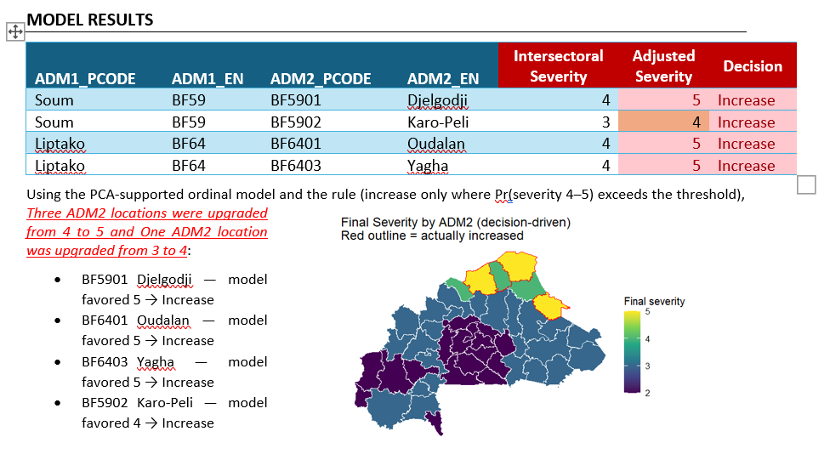
Model Output

Slide 20
3. RESPONSE ANALYSIS

Slide 21
Response Indicators for Logframe
Key Steps
  Define the Logframe: Use common pillars, modalities & activities
  Align partner activities to shared framework.
  Ensure inclusion of GBV, CP, MA, HLP.
  Use common indicators & units of analysis
  Align specialized indicators with cluster framework

Slide 22
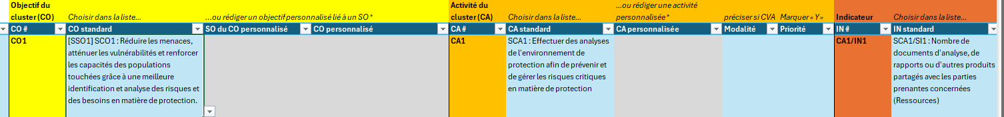
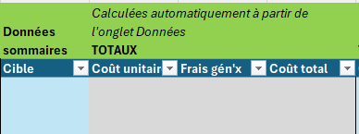
Response Indicators for Logframe
A.
SO1
CP | Establish and maintain safe spaces equipped for inclusive group activities for children’s wellbeing | Number of safe, inclusive group activity locations established and maintained for child well-being
CP | Deploy mobile teams to deliver structured group activities in mobile child-friendly settings (e.g., tents, buses, temporary setups). | Number of safe, inclusive group activity locations established and maintained for child well-being
CP | Set up safe, moderated online or hybrid platforms to reach children with structured psychosocial and developmental group content. | Number of safe, inclusive group activity locations established and maintained for child well-being
GBV | Support to safe spaces/women's centers | # of Safe Spaces for women and girls, supported
MA | Explosive Ordnance Disposal (EOD) spot task | # of critical infrastructure rendered safe (access routes, bridges, food drop zones, medical facilities, wells, camp sites, etc.)
MA | Fencing off and/or marking hazardous areas | Size of area fenced/marked in m2
COMMON ACTIVITY
COMMON INDICATOR
Establishment, support & adaptation of safe and inclusive spaces or areas
Number of safe and inclusive group activity locations secured, established and maintained for persons well-being
A.
A.
A. WHAT TO INCLUDE IN OCHA TOOL
B. WHAT TO SHARE WITH OCHA
One target
One Unit cost
per indicator
Targets for CP, GBV and MA
Overall budget for CP, GBV and MA
A.

Slide 23
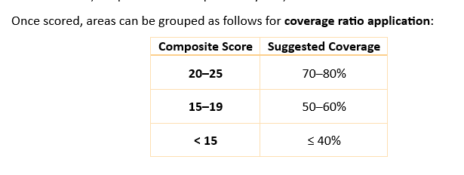
Target Setting
Apply Filters
Key factors
  Targets are refined by considering key factors such as:
  severity levels,
  access constraints,
  partner presence, and
  historical reach.
Scoring Values
  Assigning scoring values (1 - 5) to the key operational filters. These scores can then be combined to derive an Area Response Capacity Index, which in turn deter.
Apply Coverage Ratio

Slide 24
Response Indicators for Logframe
  Funding CalculationBased on: Target population, Standard unit costs, Key services (case management, MHPSS, legal aid, MRE)
  Funding = Target × Unit Cost

Slide 25
4. RESPONSE MONITORING

Slide 26
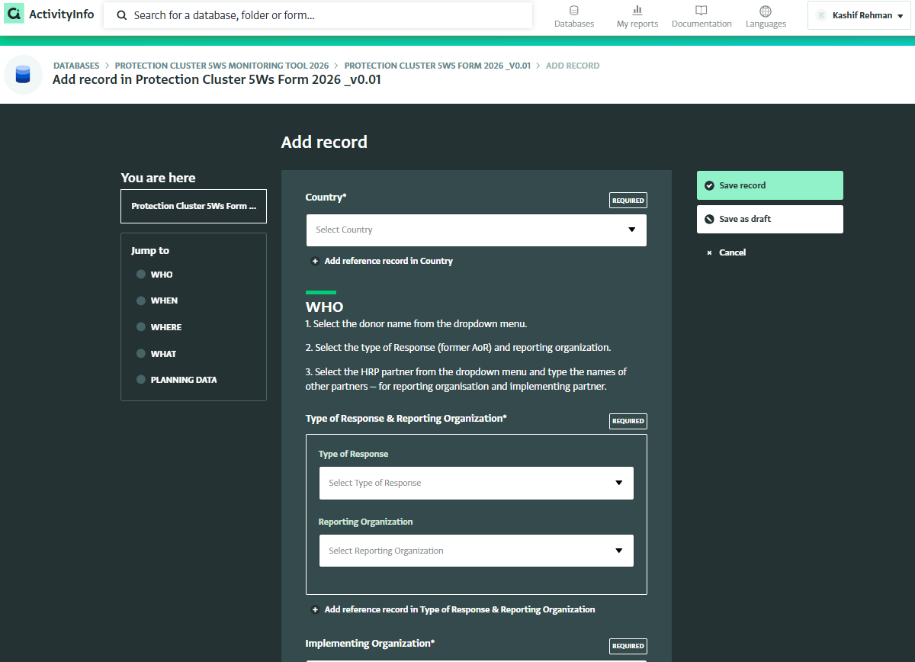
Protection Cluster ActivityInfo Tool – 5Ws

Slide 27
Q & A
Please contact Kashif & Francesco before you start planning to support you coherently given the current reset
decisions at country and global level (rehmanka@unhcr.org, michele@unhcr.org )
Notes:
The logic of the table:
The indicators are provided as example
They are an indication of indicators that OCHA-PC can look at together, using the initial protection risk severity as trigger.

