Slide 1
Protection Risk Assessment
June 2026
Notes:
"Welcome to this practical presentation to guide on the simplification of Protection Risk Assessment. In 2025 it is critical that we further streamline protection analysis, focusing on ensuring essential updates”

Slide 2


AGENDA
Protection risk assessment objectives and guidance
Refresher on modalities and adaptation in country
Brief overview of the Protection Risk Assessment Tool
THIS IS A REFRESHER SESSION.
PLEASE ASK CLARIFICATIONS OR QUESTIONS AT ANY POINT.
NOUS NE FAISONS PAS D'INTERPRÉTATION, MAIS VOUS POUVEZ NOUS POSER DES QUESTIONS ET NOUS POUVONS VOUS RÉPONDRE EN FRANÇAIS
NO OFRECEMOS SERVICIO DE INTERPRETACIÓN, PERO PUEDEN PREGUNTAR Y RESPONDEREMOS EN ESPAÑOL
Notes:
It is critical that we work towards ensuring 4 minimum standards in 2025.
Ensure update of the risk severity scoring – No need of full-scale assessments. You will see a menu of options to find the simplest and more practical approach.
Ensure we calculate the PeR in each country – This new number, the GPC calculates based on country risk assessment, is opening new channels with donors and other actors to raise the attention on protection.
Reduce timing for analysis document and be more strategic. Reach out early to GPC to simplify process or document, and aim at a PAU/Presentation of analysis ahead of the HNO scope.
Use new severity tools to simplify HNRP – This is year time from PC should be reduced, and for that decide early on in the year the level of analysis and indicators .

Slide 3
WHY: Reflection point
The protection risk assessment is a regular exercise coordinated by Protection clusters to define the severity of 15 Protection risks on a scale from 1 to 5
Why is the protection risk assessment important, according to your opinion and past experience?
Tell us in chat or freely open your mic
Notes:
It is critical that we work towards ensuring 4 minimum standards in 2025.
Ensure update of the risk severity scoring – No need of full-scale assessments. You will see a menu of options to find the simplest and more practical approach.
Ensure we calculate the PeR in each country – This new number, the GPC calculates based on country risk assessment, is opening new channels with donors and other actors to raise the attention on protection.
Reduce timing for analysis document and be more strategic. Reach out early to GPC to simplify process or document, and aim at a PAU/Presentation of analysis ahead of the HNO scope.
Use new severity tools to simplify HNRP – This is year time from PC should be reduced, and for that decide early on in the year the level of analysis and indicators .

Slide 4
1. Objectives and guidance
June 2026
Notes:
"Welcome to this practical presentation to guide on the simplification of Protection Risk Assessment. In 2025 it is critical that we further streamline protection analysis, focusing on ensuring essential updates”

Slide 5
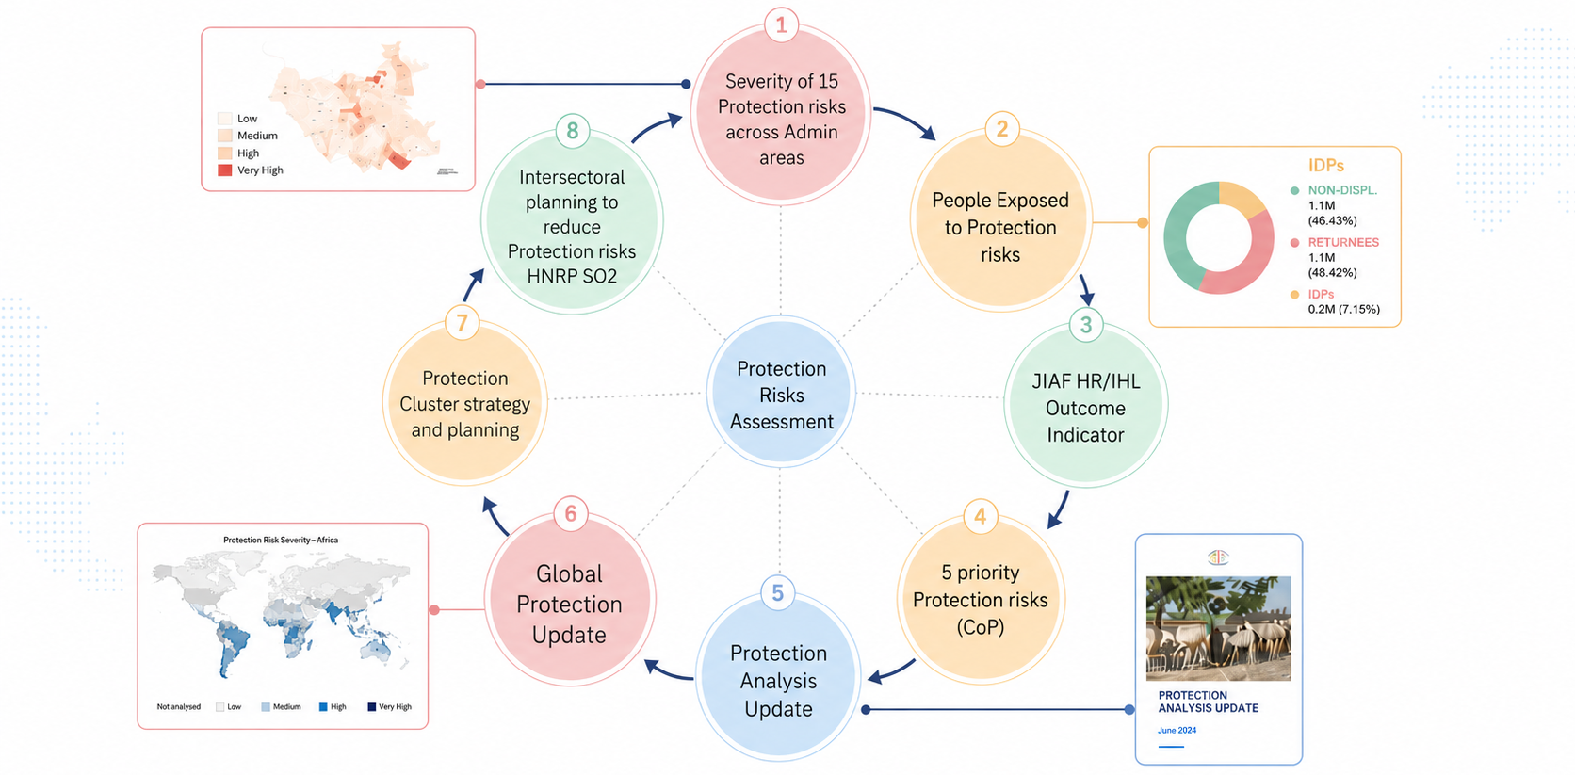
Steps and guidance: What is useful for?
Notes:
It is critical that we work towards ensuring 4 minimum standards in 2025.
Ensure update of the risk severity scoring – No need of full-scale assessments. You will see a menu of options to find the simplest and more practical approach.
Ensure we calculate the PeR in each country – This new number, the GPC calculates based on country risk assessment, is opening new channels with donors and other actors to raise the attention on protection.
Reduce timing for analysis document and be more strategic. Reach out early to GPC to simplify process or document, and aim at a PAU/Presentation of analysis ahead of the HNO scope.
Use new severity tools to simplify HNRP – This is year time from PC should be reduced, and for that decide early on in the year the level of analysis and indicators .

Slide 6
Steps and guidance: general guidance
It is critical to maintain a minimum level of update on risks.
Engage with GPC before to find the best option.
In 2026 it should be implemented across all operations
Better consultations than hard data.

Slide 7
Steps and guidance: general guidance
The GPU will be published in September. PRA should be finalized by end of July
As a minimum update the latest PRA
Risk assessment: The lowest admin, reduces workload for HNRPs
If challenging, focus only on areas / risks where there are observed changes in the context.
Notes:
Q3 In light of simplification, we have reduced the GPU to two times per year, in June and December.
For the June exercise, there is no need of full protection risk assessment but only a focused updated.

Slide 8
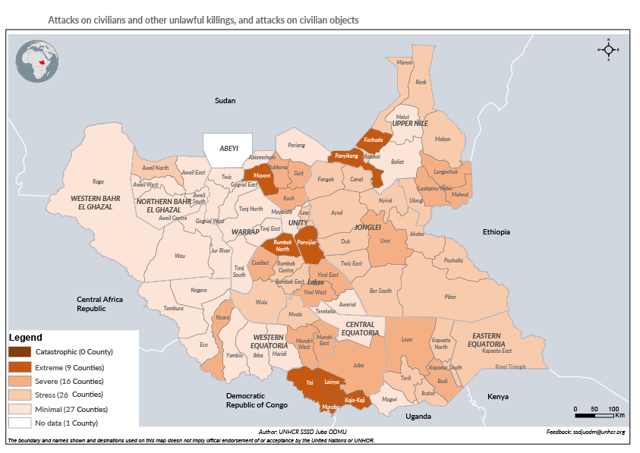
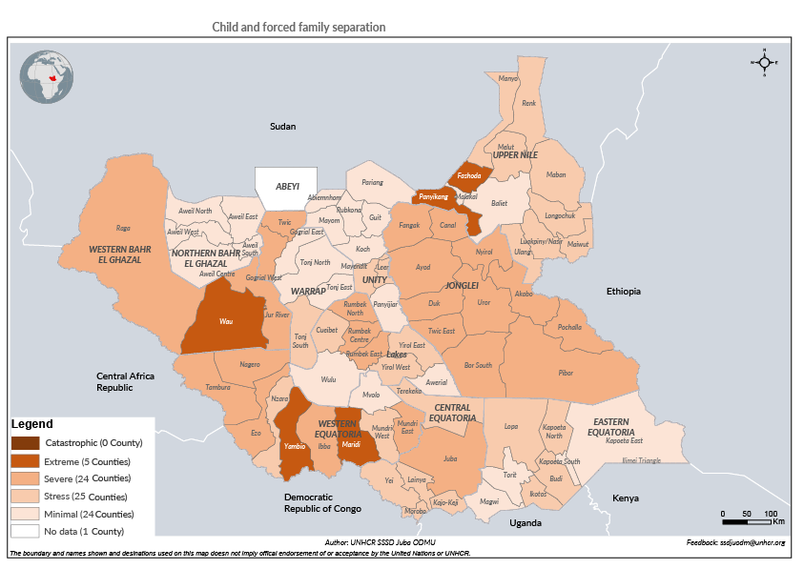

Steps and guidance: Example for reflection
Attacks on civilians and other unlawful killings, and attacks on civilian objects.
Child and forced family separation
Identify areas that need attention on specific risks
Identify areas to with compound effects of multiple risks

Slide 9
Steps and guidance: Reflection point
How would the PRA be useful to support, infuence and engage in the HNRPs?
Tell us in chat or freely open your mic
Notes:
It is critical that we work towards ensuring 4 minimum standards in 2025.
Ensure update of the risk severity scoring – No need of full-scale assessments. You will see a menu of options to find the simplest and more practical approach.
Ensure we calculate the PeR in each country – This new number, the GPC calculates based on country risk assessment, is opening new channels with donors and other actors to raise the attention on protection.
Reduce timing for analysis document and be more strategic. Reach out early to GPC to simplify process or document, and aim at a PAU/Presentation of analysis ahead of the HNO scope.
Use new severity tools to simplify HNRP – This is year time from PC should be reduced, and for that decide early on in the year the level of analysis and indicators .

Slide 10



Steps and guidance: indicative timeline
June
July August
September-December
1
2
3
PLANNING
IMPLEMENTATION
HNRP RELATED ANALYSIS
• Revise best option in country
• Inform GPC Focal Point
• Consult GPC for support
• Coordinate with OCHA for HNRP:
  • Scope setting
  • Use of PRA for HNO
  • ICCG revision
  • Plan HR/IHL outcome indicator
• Plan steps with PC coordination team
• Coordinate with Kashif to adapt tool
• Define engagement plan with GPC
• Participation of SLS cluster / HLP
• Engage other sectors:
  • Severity workshops
  • Dedicated reflection at ICCG
Contact Kashif: PeR calculation
• Ensure sharing early with OCHA (agreed):
  • Protection risk severity dataset
  • Maps
  • PAU
  • Additional dedicated analysis
  • People Exposed to Risks number
Contact Kashif: HR/IHL Outcome Indicator
Notes:
Q3 In light of simplification, we have reduced the GPU to two times per year, in June and December.
For the June exercise, there is no need of full protection risk assessment but only a focused updated.

Slide 11
2. Modalities and adaptation
June 2026
Notes:
"Welcome to this practical presentation to guide on the simplification of Protection Risk Assessment. In 2025 it is critical that we further streamline protection analysis, focusing on ensuring essential updates”

Slide 12
Modalities and adaptation: General guidance
Include as agenda point of a cluster meeting: partners reflection on changes on protection risks.
No standard approach. A menu of options is presented. They can be further adapted to context.
Focus on updating only areas of the country with major changes and/or
Focus on selected risks that the situation suggested they changed and/or
Focus on situation of specific groups if changed drastically (Policies, IDPs influx, returns, etc..
In all cases guarantee a minimum subnational consultation and some minimum evidence
Notes:
Q4 A menu of options is presented to simplify for Q2 risk assessment
Include an agenda point in a regular meeting with partners
Focus only on specific geographic areas, or protection risks or population groups.

Slide 13
Modalities and adaptation: Menu of options
COMPLEXITY | OPTION
1 | PC Coordination team value judgement update of Admin 1.
2 | Ad-hoc short value judgement workshop focused on specific Areas or Risks
3 | Consultation for targeted revision of Risk Assessment tool by SAG and core partners
4 | Round of call to subnational FPs and PC Coordination team update based on feedbacks
5 | Subnational consultation with selected partners to provide value judgement on Q4 2024 data
6 | Light embedding of risk assessment into existing protection monitoring, assessment or other monitoring.
7 | 1-day national workshops with partners to revise scores of Q4 2024 and update
8 | Half a day subnational workshops with partners to revise scores of Q4 2024 and update
9 | Map existing PC data and information against 15 protection risks, revise scoring and organize red line consultation with partners.
10 | Define core indicators for the 15 protection risks from existing protection and multisector mechanisms.
Notes:
You can find here 10 options to adapt the process in your operations. They provide a range of element combined, depending on resources and capacities.
Value Judgment vs. Evidence-Based Approaches.
Less Consultative vs. Highly Consultative.
Centralized Coordination Team Approach vs. Subnational

Slide 14
Modalities and adaptation: Menu of options
VALUE
JUDGEMENT
EVIDENCE
BASED
LESS
CONSULTATIVE
OPTION 1
Coordination team
OPTION 4
Subnational FPs
OPTION 6
Existing monitoring
OPTION 2
Light SAG
OPTION 3
Structured SAG
OPTION 5
Subnational Consult.
OPTION 7
PC Workshop
OPTION 9
Data analysis Prot.
OPTION 10
Data analysis Multi
OPTION 8
Subnat. Workshops
HIGHLY
CONSULTATIVE
Notes:
In this slide you can find the different options according to the level of resources, capacities and strategic needs in your operations. While we strongly advice for subnational consultative processes, to give solidity to our approach and ensure a more focused approach on local actors, partners and communities, you can use this to assess what is feasible

Slide 15
Modalities and adaptation : Menu of options
Did you carry out a protection risk severity assessment in Q3/Q4 of 2025
YES
NO
Can you organize subnational consultation on risk assessment?
YES
NO
Do you already make reference to the 15 protection risks for analysis and advocacy?
YES
NO
This decision tree provides indicative suggestions to adapt approach to the context. It does not exclude other modalities or a combination.
OPTION 5
Subnat. Consult.
OPTION 3
Struct. SAG
OPTION 4
Subnational FPs
OPTION 1
Coordination team
OPTION 8
Subnat. Workshops
OPTION 4
Subnational FPs
OPTION 5
Subnat. Consult.
OPTION 2
Light SAG
OPTION 9/10
Data An Prot/Mult.
OPTION 6
Existing monitoring
OPTION 6
Existing monitoring
OPTION 6
Existing monitoring
OPTION 7
PC Workshop
OPTION 9/10
Data An Prot/Mult.
OPTION 9/10
Data An Prot/Mult.
Notes:
To help you in assessing the best option or combination of options, consider:
Whether you have already conducted the risk assessment at the end of 2024
Whether there is space and capacities to organize any sort of subnational consultation and
Whether you have already aligned to 15 protection risks any process in your operation.
Use this decision tree to reach out early to the GPC to support and adapt, before starting lengthy processes. Following we will look quickly at each option.

Slide 16
Option 1: PC Coordination team value judgement update of Admin 1.
RELIABILITY: Low | Medium | High
SENSITIVITY LEVEL: Low | Medium | High
Protection Cluster coordination team to revise the aggregated severity of the 15 protection risks at national level and communicate it to the GPC.
Coordinate first and share values with GPC Country Focal
Point and Kashif.
No tool requested
NOT ADVISED
SUGGESTED SCOPE: National / Admin 1
Notes:
"The least advice options yet possible. It is the same approach used in the past, to revise severity scores only at national level by the PC Coordination Team"

Slide 17
Modalities and adaptation : Reflection point
What challenges, options or modalities would you see in your operation?
Tell us in chat or freely open your mic
Notes:
It is critical that we work towards ensuring 4 minimum standards in 2025.
Ensure update of the risk severity scoring – No need of full-scale assessments. You will see a menu of options to find the simplest and more practical approach.
Ensure we calculate the PeR in each country – This new number, the GPC calculates based on country risk assessment, is opening new channels with donors and other actors to raise the attention on protection.
Reduce timing for analysis document and be more strategic. Reach out early to GPC to simplify process or document, and aim at a PAU/Presentation of analysis ahead of the HNO scope.
Use new severity tools to simplify HNRP – This is year time from PC should be reduced, and for that decide early on in the year the level of analysis and indicators .

Slide 18
Option 2: Ad-hoc short value judgement workshop on specific Areas or Risks.
RELIABILITY: Low | Medium | High
SENSITIVITY LEVEL: Low | Medium | High
Organize a short workshop involving active SAG members to revise the risk severity scores.
If possible, share in advance last risk assessment. No need to ask for inputs
Organize discussion on key considerable changes for geographic areas or specific risks.
Facilitate quick consultation on deciding whether to revise related severity score.
SUGGESTED SCOPE: Admin 1 / Admin 2

Slide 19
Option 3: Consultation on Risk Assessment tool with SAG, and Partners.
RELIABILITY: Low | Medium | High
SENSITIVITY LEVEL: Low | Medium | High
Organize a workshop involving active SAG members, and core partners to revise the risk severity scores.
Share in advance last risk assessment and ask each actor to revise and share back.
Collate feedbacks on suggested revision and present it during the workshop.
Facilitate a joint value judgement discussion on each Risk.
Avoid lengthily discussions and focus only on critical changes.
SUGGESTED SCOPE: Admin 1 / Admin 2

Slide 20
Option 4: Subnational FPs and Coordination team update based on feedbacks.
RELIABILITY: Low | Medium | High
SENSITIVITY LEVEL: Low | Medium | High
Organize a series of call to FPs of each subnational areas. Depending on capacities, share the specific risks severity for their areas or avoid it.
Ask in advance to the subnational FP to have a light consultation
As a minimum, organize a long call and ask situations per areas.
(If capacities allow, ask them to revise the dedicated areas in the tool)
Note down specific situations/changes in areas, and using value judgement manually revise the corresponding severity in the tool.
SUGGESTED SCOPE: Admin 1 / Admin 2

Slide 21
Option 5: Subnational consultation to provide value judgement on Q4 2025.
RELIABILITY: Low | Medium | High
SENSITIVITY LEVEL: Low | Medium | High
Ask subnational FP to organize a light consultation with partners in their areas.
Share last risk assessment with FP as reference.
Ask each FP to revise scores based on their value judgement based on feedbacks.
Ask them to indicate clearly change and a short rationale
Collate the tool from different areas.
If needed, present results in a national protection cluster meeting.
SUGGESTED SCOPE: Admin 1 / Admin 2

Slide 22
Option 6: Light embedding of risk assessment into monitoring.
RELIABILITY: Low | Medium | High
SENSITIVITY LEVEL: Low | Medium | High
Avoid implementing a direct data collection and identify key questions / information needs in existing protection monitoring, partners assessment or other ongoing data collection exercise.
If it cannot be added, identify the question/data closest to understanding the risk
Compare values of 2025 vs. 2026.
If any change, and if needed revise the score for risk and area.
If needed, present results in a national protection cluster meeting.
SUGGESTED SCOPE: Admin 1 / Admin 2

Slide 23
Option 7: 1-day national workshops to revise scores of 2025 and update.
RELIABILITY: Low | Medium | High
SENSITIVITY LEVEL: Low | Medium | High
Organize a 1 day (minimum) workshop involving all partners to revise the risk severity scores.
Depending on resources and capacities, ask material to GPC
As a minimum,
  Share in advance latest severity scores with partners
  Ask to provide feedbacks for their respective areas or related risks
  Collate data and information and present results.
  Divide in WG for groups of protection risks to validate the results.
  Present results and validate in plenary.
SUGGESTED SCOPE: Admin 2

Slide 24
Option 8: Subnational workshops to revise scores of 2025 and update.
RELIABILITY: Low | Medium | High
SENSITIVITY LEVEL: Low | Medium | High
Organize subnational workshops involving core partners to revise the risk severity scores.
Share in advance last risk assessment and ask each actor to revise and share back.
Collate feedbacks on suggested revision and present it during the workshop.
Facilitate a joint value judgement discussion on each Risk.
Avoid lengthily discussions and focus only on critical changes.
If needed, present results in a national protection cluster meeting.
SUGGESTED SCOPE: Lowest admin level

Slide 25
Option 9: Map existing PC data and information against 15 protection risks
RELIABILITY: Low | Medium | High
SENSITIVITY LEVEL: Low | Medium | High
Organize all data and information available in one IM repository and tag information against the 15 protection risks and the PAF, based on the Harmonized Data Tool.
Prepare a dashboard or an aggregated report with key data updates for the 15 risks, by Threats, Consequences and Capacities
Organize a consultation within existing IM/Analysis WG for revision
Make it available to partners / SAG
Organize a dedicated workshop (2 days) to present data, and revise the scores
*This approach would simplify the HNRP process.
SUGGESTED SCOPE: Lowest admin level

Slide 26
Option 10: Define core indicators for the 15 protection risks.
RELIABILITY: Low | Medium | High
SENSITIVITY LEVEL: Low | Medium | High
Organize all data and information available in one IM repository and tag information against the 15 protection risks and the PAF, based on the Harmonized Data Tool.
Similar steps of option 9. In addition:
  Map additional data from other sectors or available mechanisms.
  Develop a scoring system (A rule book is available from the pilot in South Sudan)
  Develop a dedicated dashboard for ongoing revision with partners.
  *This approach would simplify the HNRP process.
SUGGESTED SCOPE: Lowest admin level

Slide 27
3. Rapid overview of the tool
June 2026
Notes:
"Welcome to this practical presentation to guide on the simplification of Protection Risk Assessment. In 2025 it is critical that we further streamline protection analysis, focusing on ensuring essential updates”

Slide 28
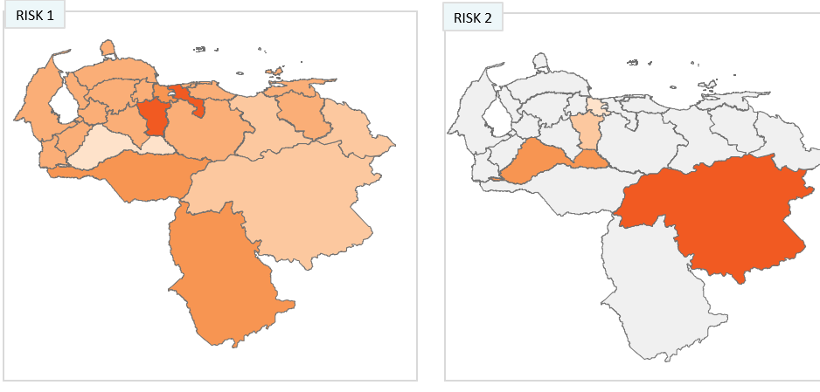
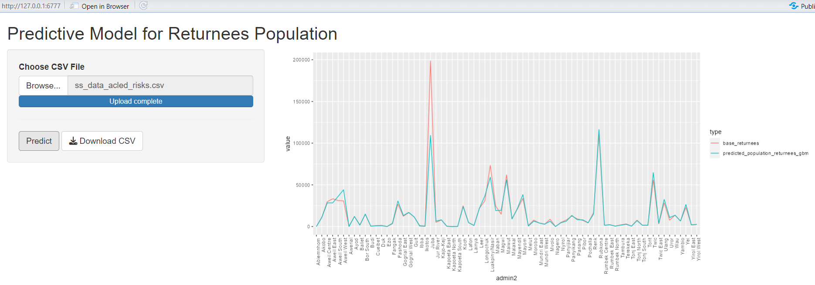



Tool overview: How it links with the HNRP process?
PROTECTION RISKS SEVERITY - GPU
VALUE JUDGEMENT ELICITATION
JUNE-AUGUST
OUTPUT: SEVERITY DATA ON 15 RISKS
PEOPLE EXPOSED TO PROTECTION RISKS
AUTOMATIZED GPC TOOL
OUTPUT: N. OF POPULATION ESTIMATED AT RISK
3 PILLARS TO DEFINE PROTECTION NEEDS
IDENTIFICATION OF NEEDS INDICATORS (6-10 CORE INDICATORS)
JUNE-AUGUST
ABILITY TO MOVE AND ACCESS TO PUBLIC SPACES
ABILITY TO PARTICIPATE IN SAFE PRACTICES AND ACTIVITIES
ACCESS TO RIGHTS AND SERVICES
OUTPUT: SEVERITY OF NEEDS
PEOPLE IN NEED
CALCULATION AND AGGREGATION
UPON DATA AVAILABILITY
OUTPUT: SUBSET OF POPULATION IN NEED - PIN

Slide 29
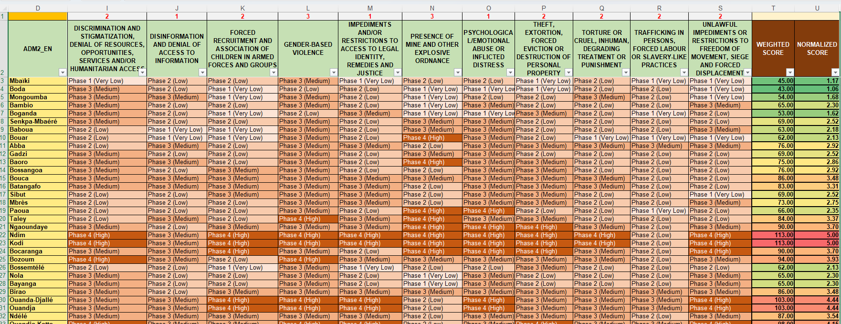
Tool overview: The Excel matrix

Slide 30
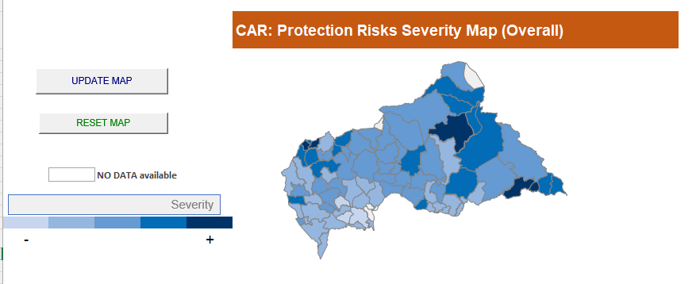
Tool overview: Tools features

Slide 31
CONTACT GPC FOR SPECIFIC SUPPORT
Please contact Kashif & Francesco before you start planning to support you coherently given the current reset
decisions at country and global level (rehmanka@unhcr.org, michele@unhcr.org )
How do you see possible doing the risk assessment and analysis? (i.e. partners footprint, workload, etc..)
Would it be further useful for the current situation in your country? (i.e. reprioritization, reset, etc..)
What is the best support we can provide? (i.e. bilateral follow up, technical Support, specific guidance, etc..)
Notes:
You can find here 10 options to adapt the process in your operations. They provide a range of element combined, depending on resources and capacities.
Value Judgment vs. Evidence-Based Approaches.
Less Consultative vs. Highly Consultative.
Centralized Coordination Team Approach vs. Subnational

