Slide 1
Durable Solutions
An Introduction and Background to Durable Solutions for Internally Displaced Persons
Presentation Slides for use as Learning Materials.
Notes:
These educational presentation slides have been developed by the Global Protection Cluster (GPC) to complement a key recommendation from the GPC’s Practical Guidance on the Role of Protection Clusters in Durable Solutions Processes.
One recommended entry point for ensuring Durable Solutions is the integration of Durable Solutions sessions into induction and protection training curricula for Protection Cluster members, national and local authorities, and other relevant partners.
These slides are designed to serve as an introduction to key concepts, definitions, approaches, and standards related to durable solutions, as well as to introduce other relevant documents that support these processes.

Slide 2
Objectives of Presentation
By the end of this session, you will be able to:
Explain the concept of Durable Solutions and its underpinning frameworks;
Present Durable Solutions as a long-term process requiring the engagement of humanitarian, development and peace building actors under the leadership of national authorities;
Apply the principles governing durable solutions processes;
Use the criteria set out as benchmark to measure progression towards durable solutions.

Slide 3
IDP Definition
IDPs are …
“persons or groups of persons who have been forced or obliged to flee or to leave their homes or places of habitual residence, in particular as a result of or in order to avoid the effects of armed conflict, situations of generalized violence, violations of human rights or natural or human-made disasters, and who have not crossed an internationally recognized state border”.
Guiding Principles on Internal Displacement

Slide 4
Who are Displacement Affected Communities?
Displacement affected communities involves all displaced populations and host communities as displaced people do not live in a vacuum.
IDPs
Refugees
Returnees
Host Communities
Notes:
Displacement affected communities (DAC) involves all displaced populations and host communities as displaced people do not live in a vacuum
You can add that IDPs, refugees and vulnerable populations often live in the same areas and share the same obstacles to access services or livelihood and employment. Adopting a DAC approach enables a more holistic and long-term response benefiting all and taking into account the impact of displacement on host communities while being aware and sensitive to the displacement related issues that IDPs and refugees might face.

Slide 5
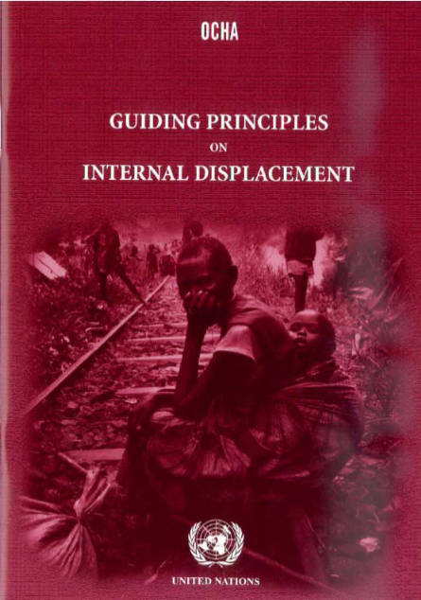
Guiding Principles
Introduction
Part I: General principles
Part II: Protection against displacement
Part III: Protection during displacement
Part IV: Humanitarian assistance
Part V: Return, resettlement and reintegration
30 principles in total
Translated and disseminated in more than 45 languages
Notes:
The Guiding Principles are not legally binding, but reflect provisions in international human rights and humanitarian law.
Over 20 states in the world have developed national laws and policies on internal displacement, in many cases incorporating or making reference to the Guiding Principles.
The Great Lakes Pact’s protocol on IDPs requires states to incorporate the Guiding Principles into their legislation
Starting point: IDPs’ human rights, not only their needs
IDPs as rights holders, authorities as duty-bearers
International community strengthens national capacity to protect IDPs

Slide 6
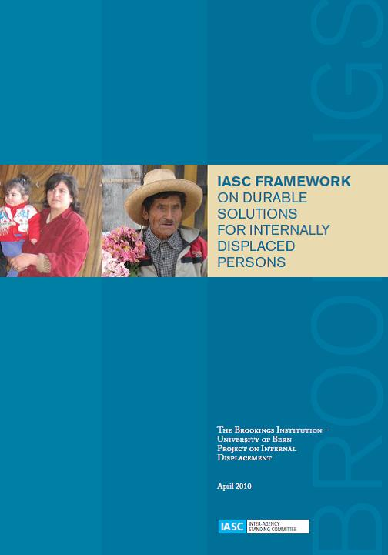
What are Durable Solutions?
Definition and Principles based on the IASC Framework on Durable Solutions for IDPs and the Guiding Principles on Internal Displacement (#28 – 30)
“A durable solution is achieved when IDPs no longer have any specific assistance and protection needs that are linked to their displacement and can enjoy their human rights without discrimination on account of their displacement.”
IASC framework on Durable Solutions 2010

Slide 7
How to Achieve Durable Solutions?
Durable Solutions can ultimately be achieved through one of these settlement options:
Voluntary return to the place of origin
Sustainable local integration in areas where IDPs take refuge
Sustainable integration in another part of the country (or relocation)
But this alone is not enough….
Notes:
Three key solutions
Return to the place of origin:
Voluntary return to areas of origin.
Challenges: Safety, infrastructure, and reconciliation.
Local Integration in areas where internally displaced persons take refuge:
Settling in host communities.
Challenges: Social acceptance, legal rights, and services.
Relocation in another part of the country:
Moving to another area within the country.
Challenges: Employment opportunities and social support.

Slide 8
Key Principles of the IASC Framework
Primary Responsibility of National Authorities – including legal frameworks, coordination mechanisms, and funding for their protection and assistance.
Unimpeded Access for Humanitarian and Development Actors
IDPs’ Rights, Needs, and Legitimate Interests must guide all policies and decisions.
Informed and Voluntary Decisions by IDPs: IDPs must have the right to make informed and voluntary decisions about their preferred durable solution—return, local integration, or settlement elsewhere—with no hierarchy imposed among these options.
Freedom to Choose and Change Durable Solutions: IDPs retain the right to return even if they initially choose local integration or settlement elsewhere.
Prohibition of Forced Returns or Relocations: Under no circumstances should IDPs be compelled to return or relocate to unsafe areas.
Non-Discrimination: IDPs must not face discrimination related to their displacement or based on other factors (e.g., race, religion, gender, age, disability, etc.). This principle also applies to host communities integrating IDPs.
Community-Based Approach: Integration of IDPs must address the needs of host or reintegration communities as well.
Continued Protection of Rights: Even after achieving a durable solution, IDPs remain protected by national and international human rights laws and international humanitarian law.
Notes:
The Guiding Principles, and the international legal framework (international human rights law and, where applicable, international humanitarian law) from which they are drawn, set out the rights and responsibilities that must be respected in the search for durable solutions. All strategies and activities aimed at supporting the search for durable solutions have to be based upon these rights and responsibilities:
Key Principles of the IASC Framework
Primary Responsibility of National Authorities
National authorities have the primary duty to provide durable solutions for IDPs, including legal frameworks, coordination mechanisms, and funding for their protection and assistance.
Access for Humanitarian and Development Actors
National and local authorities must allow rapid and unimpeded access for international actors to assist IDPs in finding durable solutions.
IDPs’ Rights, Needs, and Legitimate Interests
The rights, needs, and interests of IDPs must guide all policies and decisions related to displacement and durable solutions.
Informed and Voluntary Decisions by IDPs
IDPs must have the right to make informed and voluntary decisions about their preferred durable solution—return, local integration, or settlement elsewhere—with no hierarchy imposed among these options.
Freedom to Choose and Change Durable Solutions
IDPs retain the right to return even if they initially choose local integration or settlement elsewhere. Exercising this right requires meaningful options and flexibility over time.
Prohibition of Forced Returns or Relocations
Under no circumstances should IDPs be compelled to return or relocate to unsafe areas. Decisions to assist returns or relocations should ensure minimum safety and living conditions.
Non-Discrimination
IDPs must not face discrimination related to their displacement or based on other factors (e.g., race, religion, gender, age, disability, etc.). This principle also applies to host communities integrating IDPs.
Community-Based Approach
Integration of IDPs must address the needs of host or reintegration communities as well, ensuring fair resource distribution and reducing tensions between populations.
Continued Protection of Rights
Even after achieving a durable solution, IDPs remain protected by national and international human rights laws and, where applicable, international humanitarian law.

Slide 9
Eight IASC criteria to measure to which extent solutions have been achieved
A mere physical movement does not amount to a durable solution. IDPs who have reached a durable solution will enjoy without discrimination:
1.
Long-term safety, security and freedom of movement
2.
Adequate standard of living
3.
Access to livelihood and employment
4.
Access to effective mechanisms to restore Housing, Land and Property (HLP) or provide compensation
6.
Voluntary reunification with family members separated during displacement
7.
Participation in public affairs
8.
Access to justice and remedies
5.
Access to and replacement of personal documentation
Notes:
More detailed (optional) slides on each of these criteria can be found at end of presentation.

Slide 10
Ensuring a Rights-Based Approach for Durable Solutions
IDPs are in a position to make a voluntary and informed choice on what durable solution they would like to pursue;
IDPs effectively participate in the planning and management of durable solutions, so that recovery and development strategies address their rights and needs;
IDPs have access to humanitarian and development actors;
IDPs have access to effective monitoring mechanisms; and
In cases of displacement caused by conflict or violence, peace processes and peacebuilding involve IDPs and reinforce durable solutions.

Slide 11
Overall, there are three main ideas governing Durable Solutions Processes
Voluntariness
Informed decision making
Safety
Physical
Material
Dignity
No unconditional return
At their own pace
Freedom of movement
Legal
Prohibition of forced return
No separation of families
No manipulation
Notes:
Key messages:
Voluntariness implies that the displaced persons freely decides to go back home, in the absence of any physical, psychological, or material coercion.
Safety includes three dimensions:
Physical safety (e.g. freedom from risk of persecution, unlawful detention, discriminatory treatment and sexual violence and other forms of exploitation);
Legal safety (e.g. legal systems are in place to deliver justice, and there are no legal barriers preventing people from returning to and reintegrating in their countries);
Material safety (e.g. returnees have access to a means of livelihood and basic services, such as potable water, sanitation facilities, health care and education).
Dignity implies that the human rights of the individual are respected all the time, including the right to life, liberty, freedom of movement, and the unity of the family

Slide 12
Challenges in Achieving Durable Solutions
Protracted Displacement: Difficult articulation between humanitarian assistance and development support leaving large numbers of displaced persons in a marginalized situation.
Political Will and Governance: Lack of commitment to IDP protection and solutions.
Resource Constraints: Limited funding for long-term solutions.
Multicausality and climate change: Displacement causes are multifaceted and exacerbated by climate-related disasters.
Lack of participation or consideration of what IDPs consider as solutions for themselves.

Slide 13
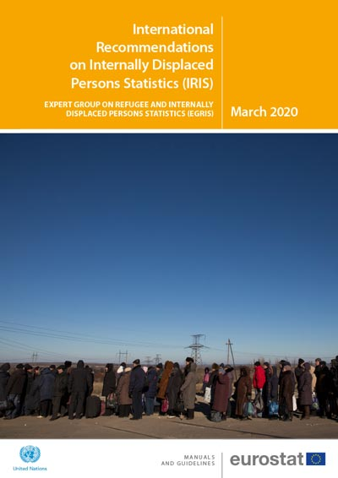
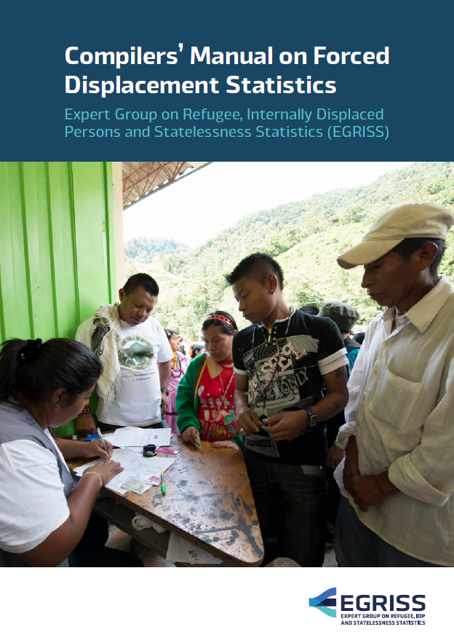
IASC Framework Operationalization: Solutions Data and Statistics
2015: IASC Solutions analysis guide and library of standardized indicators based on the 8 IASC criteria.
2020: UN Statistical Commission endorsed the International Recommendations on IDP Statistics (IRIS) developed by the EGRISS
Compilers’ Manual on Displacement Statistics.
Notes:
In 2015, an inter-agency process was established to operationalize the IASC Framework on Durable Solutions under the leadership of the Mandate of the Special Rapporteur on Human Rights of IDPs and coordinated by the Joint IDP Profiling Service (JIPS). This process resulted in a solutions analysis guide and library of standardized indicators.
The most recent progress was made at the level of the UN Statistical Commission. In 2020, the Commission endorsed the International Recommendations on IDP Statistics (IRIS) developed by the Expert Group on Refugees, IDP and Statelessness Statistics (EGRISS).
The aim of the IRIS is to promote the production, quality, comparability, coherence and dissemination of statistics on internal displacement.
The recommendations present a comprehensive discussion of the technical issues, potential uses of data sources, and recommendations to improve the availability of statistics on IDPs.
A Compilers’ Manual on Displacement Statistics (for both refugees and IDPs) has also been finalised.

Slide 14
The Secretary General’s Action Agenda on Internal Displacement
“More of the same is not enough !
The plight of internally displaced persons is more than a humanitarian issue. It takes an integrated approach – combining development, peacebuilding, human rights, climate action and disaster risk reduction efforts.”
Notes:
The growing number of IDPs and the protracted nature of their displacement led the UN Secretary-General in 2020 to establish a High Level Panel on Internal Displacement
The HLP report (September 2021) concluded that there is an urgent need to:
go beyond addressing internal displacement as a humanitarian crisis and understand that it is directly linked to broader challenges of governance, development, human rights and peace; and
link the internal displacement debate more closely to the interconnected realities of climate change, urbanization and fragility
The HLP recommended that development, peace and disaster risk reduction actors be engaged much earlier in finding durable solutions to internal displacement
As a follow-up to the HLP Report, the UN Secretary-General’s Action Agenda on Internal Displacement (launched in June 2022) outlines 31 commitments for the UN system with three overarching goals;
promote durable solutions to internal displacement;
better prevent new displacement crises – whether conflict or disaster and climate related – from emerging; and
Ensure that those facing displacement receive effective protection and assistance.
The Secretary-General also requested UN development, peacebuilding, humanitarian, human rights, disaster risk reduction and climate change actors to develop global institutional plans by the end of 2022 to outline how they will reinforce their internal capacities and engagement on solutions to internal displacement,

Slide 15
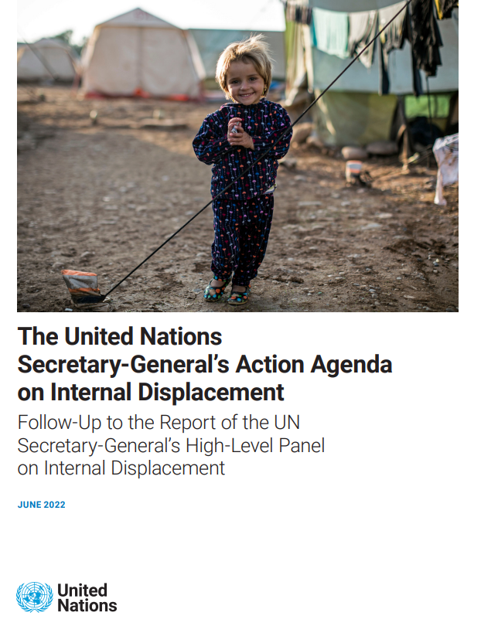
Action Agenda on Internal Displacement
Key Commitments in the Action Agenda
The UN commits to:
Strengthening national leadership and ownership of solutions
Integrating displacement solutions into national development plans
Expanding financing models for sustainable solutions
Enhancing collaboration between humanitarian and development actors
Notes:
The United Nations Secretary-General's Action Agenda on Internal Displacement, introduced in June 2022, outlines a comprehensive strategy to address internal displacement. This agenda builds upon the recommendations of the High-Level Panel on Internal Displacement and emphasizes a transformative approach to resolving displacement crises.
Key Objectives of the Action Agenda:
Support IDPs in Achieving Durable Solutions: Facilitate conditions that enable internally displaced persons (IDPs) to sustainably reintegrate into their places of origin, integrate locally, or settle elsewhere in the country.
Prevent New Displacement Crises: Implement measures to address and mitigate the root causes of displacement, thereby reducing the occurrence of new displacement situations.
Ensure Effective Protection and Assistance: Provide timely and adequate protection and assistance to those currently facing displacement, addressing their immediate and long-term needs.
These objectives are interconnected, recognizing that sustainable solutions require a holistic approach encompassing prevention, immediate response, and long-term recovery.
Implementation and Progress:
The Action Agenda includes 31 specific commitments aimed at promoting durable solutions, preventing future displacement crises, and ensuring protection and assistance for IDPs. It calls for enhanced collaboration among national governments, international organizations, and other stakeholders to effectively address internal displacement.
As of mid-2024, significant progress has been reported, particularly in strengthening government leadership and integrating displacement considerations into national development plans. The appointment of a Special Adviser on Solutions to Internal Displacement has further bolstered efforts to coordinate and implement the Action Agenda's commitments.
The Secretary-General's Action Agenda represents a pivotal step toward transforming the global response to internal displacement, emphasizing the need for comprehensive, rights-based, and sustainable solutions.

Slide 16
Three Interlinked Goals
Help IDPs find a durable solution to their displacement
No solution is sustainable if another crisis is looming ​
Better prevent new displacement crises from emerging
​No assistance will be sufficient if underlying drivers remain unresolved ​
Ensure those facing displacement receive effective protection and assistance ​
Prevention cannot succeed if past crises have not been addressed

Slide 17
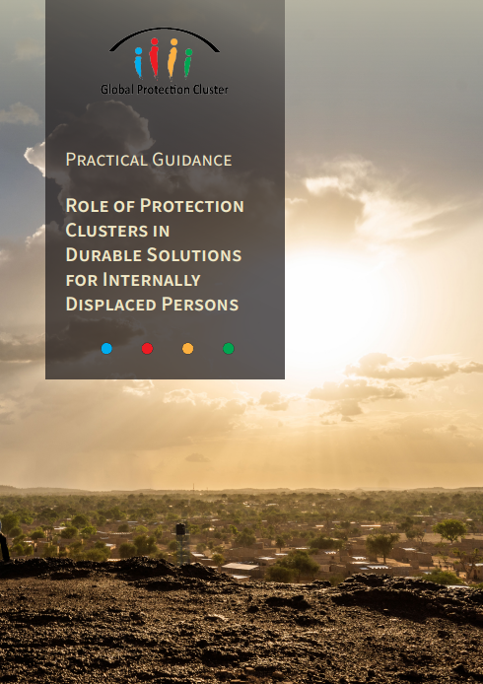
Role of Protection Clusters in Durable Solutions Processes
Practical Guidance
Global Protection Cluster
Published in March 2025
Main Goal: Define the role of the Protection Cluster and its Areas of Responsibility (AoRs) in durable solutions processes. Ensure protection remains central to solutions planning and programming.
Target Audience: Protection Cluster & AoR Coordinators. Additionally, Protection Cluster members, where applicable.
Specific Objectives: Provide practical entry points for Protection Clusters to engage in durable solutions from the onset of displacement crises.
This Guidance can be found at https://globalprotectioncluster.org/themes/durablesolutions.

Slide 18
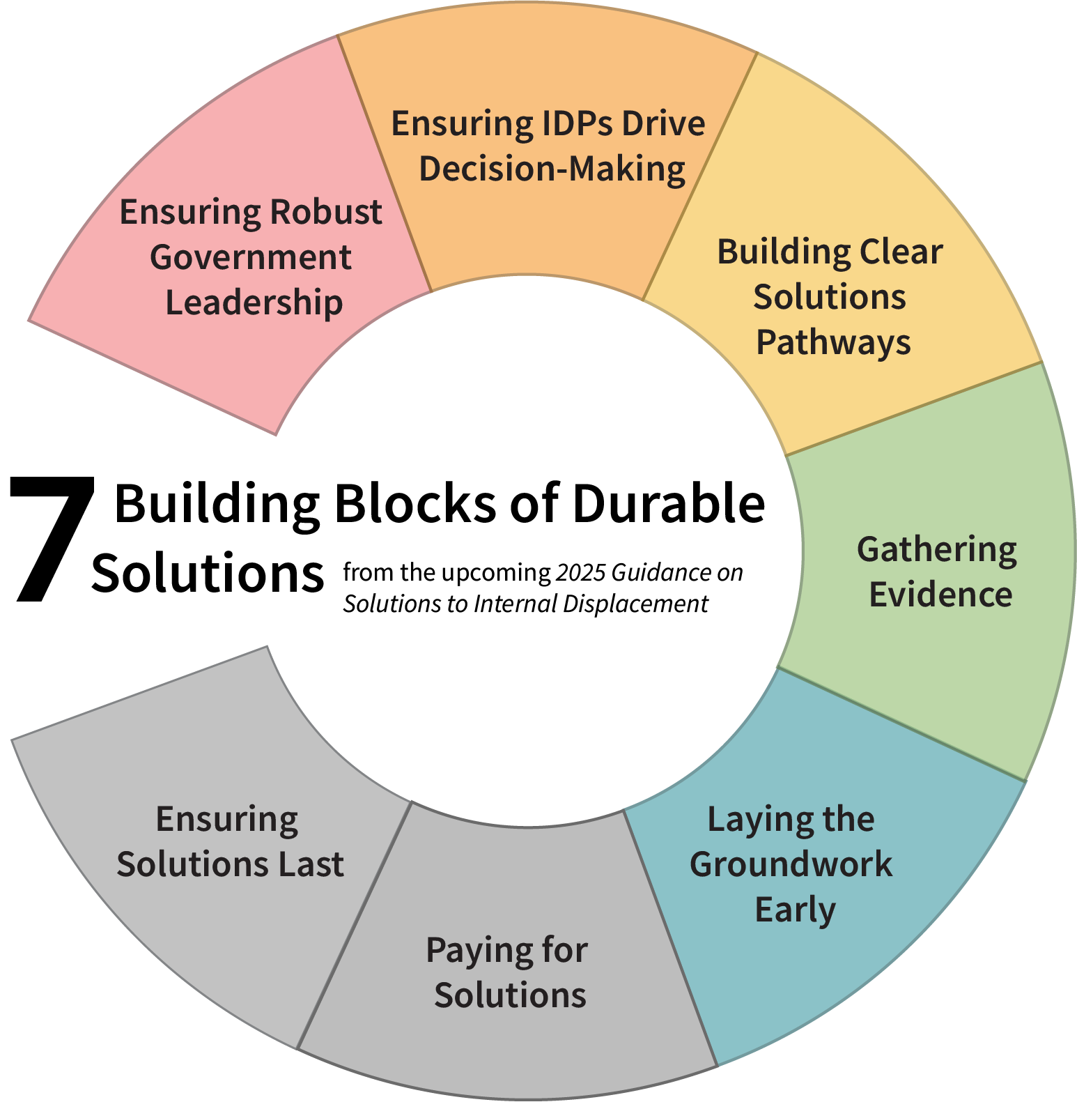
Role of Protection Clusters in Durable Solutions Processes
Practical Guidance
Global Protection Cluster
Based on five proposed entry points.
Combines Guidance from two key documents:
2025 Guidance on Solutions to Internal Displacement
Utilises five of the seven building blocks from the 2025 Guidance on Solutions to Internal Displacement as key entry points.
IASC Framework
Links the building block to 6 of the IASC Criteria, most relevant for Protection Clusters.
Notes:
In 2022, the UN Secretary General developed the Action Agenda on Internal Displacement to prioritise and improve the global response to internal displacement. It calls for a shift toward a more concerted and integrated approach across the HDP nexus under the leadership of the HC/RC to support government-led, development-oriented solutions. One of its key outputs is the upcoming release of the 2025 Guidance on Solutions to Internal Displacement, which identifies seven building blocks for solutions pathways (Figure 1) that can also be considered potential entry points for the Protection Cluster.
Entry Points for Protection-Centred Durable Solutions
The IASC Framework and the building blocks outlined in the 2025 Guidance on Solutions to Internal Displacement provide protection actors with critical entry points for laying the ground for progressive solutions processes. These entry points should be utilized from the onset of the crisis, ensuring that protection guides key steps of solutions planning.
This guidance is structured around five proposed entry points using five of the seven building blocks from the upcoming 2025 Guidance on Solutions to Internal Displacement, and linking them with the corresponding Principles and Criteria from the IASC Framework on Durable Solutions for IDPs (outlined on pages 4-5). It focuses on six of the interlinked IASC 8 Criteria. These criteria are the most prominent and relevant for Protection Clusters, while recognizing that the criteria are interrelated and interdependent and that protection mainstreaming and a multi-sectoral approach to solutions are essential to laying the foundation for long-term solutions for displaced persons.
The guidelines emphasize joined-up assessments, analysis and planning in partnership with other sectors and clusters. The table opposite illustrates how the IASC framework principles and criteria interact with the protection relevant building blocks in the 2025 Durable Solutions guidance, forming a working framework for protection actors and clusters.

Slide 19
Pathways to Success
Inclusive planning: Engaging IDPs in decision-making.
Engaging with national and local authorities on durable solutions early one and strengthening partnerships between governments and organizations.
Including IDPs and displacement in national development plans and sectoral development planning and related budgets.
Investing in area-based planning and community-based approaches.
Promoting resilience through development initiatives.

Slide 20
Conclusion
Durable Solutions are about the access to rights and services without discrimination based on displacement.
It can be done through voluntary return, local integration or relocation, abiding by safeguards and principles guiding the durable solutions processes.
Creating a conducive environment for the achievement of Durable Solutions is a humanitarian, development and peace building process.
Concerted efforts involving … governments, international and non-governmental organisations and, most importantly, IDPs themselves are required to gradually make progress.

Slide 21
Thank you for listening. Questions?

Slide 22
Additional Material / Slides.

Slide 23
1. Long-term Safety, Security & Freedom of Movement
Criteria | Sub-Criteria | Why is it important for lasting solutions?
Long–term safety, security and freedom of movement. | Perceptions of security threats to IDPs | It is important to understand not only past experiences in relation to safety (violence, disaster-related hazards, etc.), but also IDPs’ perceptions of their potential future risk exposure. Understanding incidents of insecurity is important, as these influence the decisions and strategies of households or individuals. They can also indicate specific vulnerabilities when compared to other nondisplaced groups. Restrictions on freedom of movement can hamper progress towards durable solutions.
 | Safety and security incidents (e.g. physical, sexual, psychological violence or exposure to other types of dangers)
 | Reporting of safety and security incidents
 | Restrictions to freedom of movement
Notes:
Right to physical security (GP 10,11,12,13):
a. during movement
b. in areas of return/resettlement
Parameters:
Security conditions
Physical security
Freedom of movement (GP14)

Slide 24
2. Adequate Standard of Living
Criteria | Sub-Criteria | Why is it important for lasting solutions?
Adequate standard of living. | Access to basic services and goods: drinking water and sanitation, education and health | Because IDPs who have achieved a lasting solution must enjoy, without discrimination, a decent standard of living that includes at least (GP 18): Shelter Health care Food Drinking water Sanitation, and Education Decent standard means that they are available in sufficient quantity and quality, that they are accessible and appropriate (that take into account gender and age differences, and that they are culturally appropriate).
 | Food security
 | Tenure security (e.g. tenure documentation), protection against evictions, etc., and decent housing conditions.
Notes:
Basic necessities of life (GP 18)
Food security, Basic shelter and housing, Education, Health: Water and sanitation
Indiscriminate access to shelter, health care, food water, sanitation and other means of survival.
IDPs should be guaranteed satisfaction of such rights regardless of the circumstances and without discrimination.
GP18.3 also refers to the need to include women in planning and distribution of basic supplies.
National authorities are primarily responsible hence they have to make the required budgetary allocation: IDPs should have access to public services to meet their basic necessities on an equal basis with the rest of the population.
Though ESCR satisfaction is subject to resource availability and should be progressively achieved, there is a minimum core obligations to deliver that needs to be fulfilled.

Slide 25
3. Access to Livelihood and Employment
Criteria | Sub-Criteria | Why is it important for lasting solutions?
Access to livelihood and employment | Employment | IDPs who reached a solution must be able to satisfy their basic socio-economic needs at the same level as the NON-displaced populations. To understand if this is the case, you need to: Analyse access and employment conditions to identify potential discrimination; Identify alternative sources of household income (e.g. access to social services, or informal support systems); Assess whether IDPs are exhausting limited coping mechanisms for their daily subsistence (e.g. depending on humanitarian aid or loans to cover basic needs) Access to livelihoods is closely linked to the analysis of a decent standard of living.
 | Household Economy
 | Access to productive assets, markets and financial services
Notes:
GP 22.1(b)
Arable land for farmers;
Loss/replacement of livestock for pastoralists and shepherds;
Employment opportunities in the informal sector
Access to credit for traders and storekeepers;
Offer of vocational training.

Slide 26
4. Access to Effective Mechanisms to Restore HLP or Provide Compensation
Criteria | Sub-Criteria | Why is it important for lasting solutions
Access to effective mechanisms to restore HLP or provide compensation | Ownership/ tenancy before displacement | IDPs who have achieved a durable solution, have the right to access timely mechanisms to return housing, land or property, regardless of whether they return or seek integration in reception places or if they decide to move to another place. This criterion applies not only to residence property, but also to commercial and agricultural property, as well as leases. Often violations of property, land or housing rights are the same causes of displacement and constitute one of the greatest challenges to achieve durable solutions. These sub-themes should be analysed in conjunction with the sub-theme of housing and tenure security
 | Access to mechanisms for housing land and property (HLP) restitution/ compensation
Notes:
Timely restitution of HLP, regardless of their settlement option, is the preferable remedy
But in some cases it may be more equitable to compensate the owner. Alternative solutions should be found for temporary occupants in particular if they are not
These standards apply not only to residential, agricultural and commercial property, but also to lease and tenancy agreements.
In addition, right of restitution/compensation is recognized regardless of IDPs having formal or informal titles or rights (on the basis of of mere / uncontested use or occupation).
People with special attachment to their lands are guaranteed enhanced protection.
Process of restitution of HLP can be time-consuming. It is thus necessary to have an effective and accessible mechanism (free legal assitance?) In some cases it may be appropriate to establish special institutions; in other situations traditional property dispute mechanisms.

Slide 27
5. Access to and Replacement of Personal Documentation
Criteria | Sub-Criteria | Why is it important for lasting solutions
Access to and replacement of personal documentation. | Possession of IDs and other personal documents | During the displacement it is common to lose documents necessary to exercise and enjoy legal rights such as passports, identification documents, birth certificates, electoral cards, school or university records, professional or academic certificates, social security cards, etc. In some contexts it is very difficult to obtain a replacement of personal documentation and the IDP is required to return to the place from which it was displaced. In other cases, IDPs have never owned or processed documentation of this type.
 | Incidence of documentation loss and access to replacement
 | Registrations

Slide 28
6. Voluntary Reunification with Family Members Separated during Displacement
Criteria | Sub-Criteria | Why is it important for lasting solutions
Voluntary reunification with family members separated during displacement. | Incidence of family separation and access to voluntary reunification | Family separation is a protection concern that must be analysed in the context of durable solutions. The analysis of durable solutions must take into account the extent to which IDPs are affected by family separation and inquire about their access to reunification services compared to other non-displaced population. Family separation in some cases is also a coping mechanism, therefore the reasons for separation must be analysed

Slide 29
7. Participation in Public Affairs
Criteria | Sub-Criteria | Why is it important for lasting solutions
Participation in public affairs. | Participation in public affairs | The level of participation of IDPs compared to the non-displaced population may indicate the levels of integration and social cohesion between groups and within groups, or the potential marginalization of IDPs. Participation in relevant decision-making processes is considered a right within the IASC reference, but it is also a fundamental tool for the identification, design, planning and implementation of measures that are essential to guarantee other rights.
 | Participation in reconciliation and confidence- building initiatives

Slide 30
8. Access to Justice and Remedies
Criteria | Sub-Criteria | Why is it important for lasting solutions?
Access to justice and remedies. | Use of mechanisms for effective remedies, incl. access to justice, reparations and information about the causes of violations | Ensuring effective reparations for human rights violations can have a substantial impact on the chances of moving towards a durable solution. The inability to secure effective reparations may increase the risk of further displacement in the future, may impede reconciliation, or create a prolonged feeling of injustice in IDPs. It is essential for peace and stabilization processes. It is also important to know how much access to reparation mechanisms influences the decisions that IDPs make about durable solutions

